Slide 1
3 Mindset Hacks
High Achievers Need
to Avoid Burnout

Slide 2
21%

Slide 3
High Engagement = Increased Productive

Slide 4
Do You Struggle Against Your Own Mind?

Slide 5
Burnout Pyramid
Engagement = 0%
Stage 5
Engagement = 25%
Stage 4
Engagement = 50%
Stage 3
Engagement = 75%
Stage 2
Engagement = 100%
Stage 1

Slide 6
Being in a high demand, high pressure, high stress job isn’t for the faint of heart.

Slide 7
My current job of 15 years enables me to…

Slide 8
climb the corporate ladder
get accelerated promotions
consistently be a top performer
and have a salary to go with it!

Slide 9
But glitz and glamour couldn’t mask the daily and sometimes hourly struggles of burnout.

Slide 10
When Dr. Sharon challenged me to take a break, take a step back and do things for myself, I was fearful of the repercussions.

Slide 11
I thought that my team would see that I wasn’t around and think I was disengaged.

Slide 12
I wouldn’t be at their beck and call. I would be passed over for the next role.

Slide 13
This was a detriment to my own balance.

Slide 14
With Dr. Sharon’s guidance, I took the fear head on and tested my hypothesis of taking a break and taking time for myself in the middle of the day.

Slide 15
It was a foreign concept that I could take time away from work.

Slide 18
Know The

Slide 21
My results are not typical

Slide 22
Does This Sound Like You?

Slide 23
“I wish I hadn’t worked so hard.”

Slide 24
“I wish I had let myself be happier.”

Slide 27
Reflection
Everything In Your Life Is A Reflection Of You

Slide 28
Two Types
Of People
How Could You?!
How Can I!

Slide 29
Are you afraid you’re a fraud who’s about to get discovered?

Slide 31
I am an imposter
Work harder
Burn out

Slide 33
Do you tend to see the glass half empty?

Slide 34
Stressed
Anxious
Drained

Slide 35
You Can Change Your Outlook
Happy
Energized
Calm

Slide 36
“Years of negative thinking had gotten me into a technically good place in life where I was miserable – a scary place of burnout, fatigue, demoralization, and finally depression…”

Slide 37
“… I was and continue to be (happily) shocked at the change in perspective that working with Dr. Sharon helped me to take, and by the impact that it has had on my life.”

Slide 38
Do you strive for perfection?

Slide 40
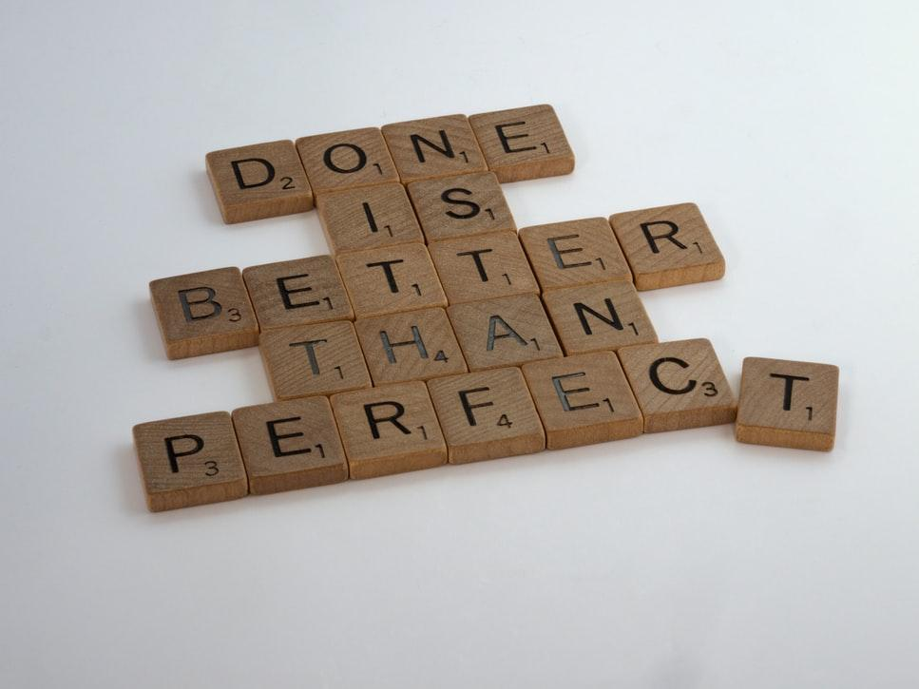

Slide 41
Perfectionism
Procrastination

Slide 42
3 Mindsets That
Lead to Burnout
Imposter Sx
Glass Half Empty
Perfection Seeker

Slide 43
Reflection
Your Experience in the World is
a Reflection of YOU

Slide 44
Reflection
Are You Managing Your Mind…
Or is Your Mind Managing You?

Slide 46
The Winning Formula
Create a mental image of how you want to feel
Improve your self-talk
Work strategically while employing self-compassion
Invest in mentoring

Slide 47
Claim Your Bonus Gift!
Sign up at: www.7dayburnoutchallenge.com

Slide 48
Do Your Life’s Work.
Smart.

Slide 49
Gain clarity about your goals
Uncover the patterns that keep you stuck
BOOK IN
A CALL
Go to: www.BookAChatWithSharon.com
Create a step-by-step plan to living life on your terms

