Slide 1
Integrating Patient Safety and Clinician Well-Being, Using Human Factors Science
Michael R Privitera MD MS
Professor of Psychiatry
Medical Director, Medical Faculty and Clinician Wellness Program
University of Rochester Medical Center
Chair 2015-2019, Medical Society of the State of New York task Force on Physician Stress and Burnout
Michael_Privitera@urmc.Rochester.edu
.
Champions of Wellness Summit 2021

Slide 2
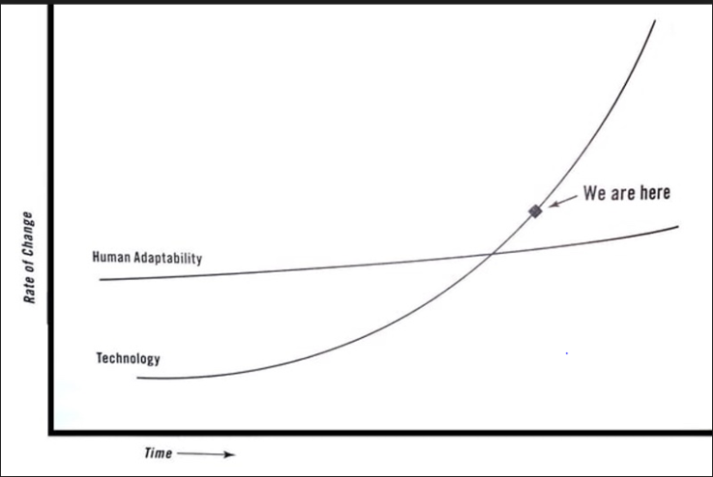
Technological Advancements Have Surpassed Human Cognitive Adaptation
Technological change will continue to out-pace human adaptability
Technology increases connectivity, tracking, accountability, and expectations beyond work hours
Need smarter ways of
education, leadership,
resources to help
Human Adaptability
Technology costs are low, personnel costs high, which leads to a decrease in staffing
Currently
Human Adaptability
Technology that is functional but not usable spins off more “shadow work” on remaining employees and patients as well.
Technology
Surrounding culture “normalizes deviance”, dulls internal feedback that we are living in dangerous and unsustainable circumstances
*Adapted from Teller E. and Moore G. in Friedman T. Thank you for being Late. Farrar, Straus Giroux Publishers 2016
# Lambert C. Shadow Work. The unpaid, unseen jobs that fill your day. Counterpoint. Berkley. 2015
2

Slide 3
Shadow Work
“Unpaid, unseen jobs that fill your day”.
Described by Harvard sociologist Craig Lambert (2015)
Technology increases “disintermediation”, i.e., reduction
of intermediaries (humans that were there to help)
between producers and consumers
Time and effort is absorbed by the consumer/worker-
taken from discretionary time/free time/ off work time.
Often not seen or accounted for by senior leader decision-makers (work is
in the shadows) due to hierarchy of hospital systems and culture of
medicine (endurance and silence).
Massive source of excessive mental workload.

Slide 4
Medical Error and Clinician Burnout: Predominantly Systemic Causes of Both
The Institute of Medicine (IOM) 1999 Report, To Err is Human: Building a Safer Health System emphasized that the majority of errors in healthcare are the result of systemic influences.¹
The majority of occupational stressors causing burnout are also the result of systemic factors.²
The quality paradox: Many of the well-intended interventions to improve specific elements of quality, safety or value, when taken in total, are contributing to health system dysfunction by the cumulative impact on workload and burnout at the point of care.³
Stress at work has been increasing over the last decades, as measured by the same instrument over time⁴, yet we do not currently advise leaders and healthcare decision-makers to budget highly trained cognitive resource as they might money or personnel.
The higher the cognitive load on clinicians the higher the risk of Burnout⁵
Kohn, L.T., Corrigan, J., Donaldson, M.S. , To err is human: building a safer health system. 2000, Institute of Medicine. National Academy of Sciences: Washington, D.C
Privitera MR, Attalah F, et al . Physicians’ electronic health record use at home, job satisfaction, job stress and burnout. 2018 Journal of Hospital Administration. Vol 7, No 4.. 52-58
3. Sinsky CA and Privitera MR. Creating a Manageable Cockpit: A Shared Responsibility. JAMA Int. Med . June 2018.; 178( 6):741-42
Cohen S, Janicki-Deverts D. Who’s Stressed? Distributions of Psychological Stress in the United States in Probability Samples from 1983, 2006, and 2009 Journal of Applied Social Psychology, 2012, 42, 6, pp 1320-1334
Harry E Sinsky C et al. Physician Task Load and Risk of Burnout in US Physicians in a National Survey. The Joint Commission Journal of Patient Safety 2020 000: 1-10.
4

Slide 5
The Impact of Clinician Burnout
Institutional & Patient Effects
Financial Effects
Personal Effects
Increased risk of medical errors (200%)
Increased malpractice claims
Disruptive behavior
Reduced empathy for patients
Reduced patient adherence to treatment regimens
Reduced patient satisfaction
27% drop in patient
satisfaction scores
40% of turnover costs attributed to work stress
114% increase of medical claims by employees.
30% of short-term and long-term disability costs
Higher Suicide Rate among physicians- 400/yr.
Substance abuse
Divorce
Coronary Heart Disease:
CHD 1.4 fold up to 1.79 at high burnout levels
Reduced career satisfaction
Spearman’s rank correlation coefficient 0.628, P < 0.001*
*Devoe J, et al. Med Care. 2007 January ; 45(1): 88–94.
5

Slide 6
From the Triple Aim to the Quadruple Aim Framework
Triple Aim 2008
Quadruple Aim 2014
Importance of Fourth Aim : Help to guide technical device companies, regulators, legislature and other decision-makers to remember to incorporate human factors in delivery of care when considering the other three factors.
6

Slide 7
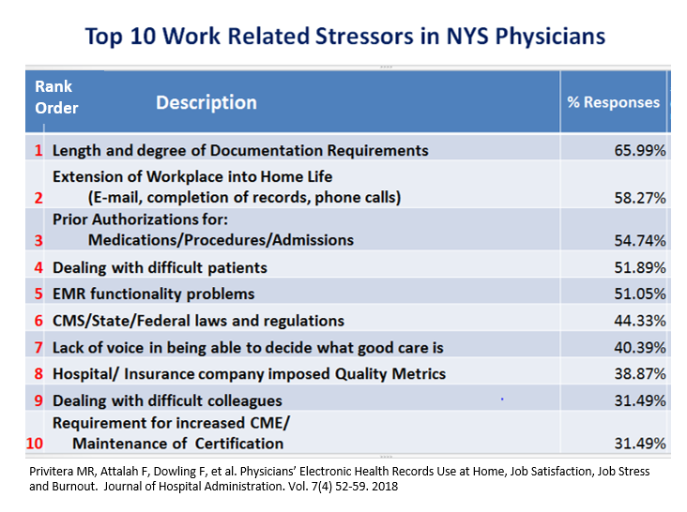
National Academy of Medicine (NAM): Twelve Major Drivers influencing burnout in the United States:
Drivers of Burnout
Medical Society of the State of New York (MSSNY)
Top 10 Work Related Stressors in NYS Physicians
The healthcare industry
Laws regulations and standards
Healthcare reform and payment policies
Medical record documentation and coding requirements
Quality measurement and reporting
Prescription drug monitoring programs
Maintaining privacy and security
Prior authorization processes
Professional licensure
Maintenance of certification (MOC)
Professional liability
The patient-physician relationship.
80% are systemic
Privitera MR, Attalah F, Dowling F, et al. Physician electronic Health Records
Use at Home, Job Satisfaction, Job Stress and Burnout.
Journal of Hospital Administration. Vol. 7(4) 52-59. 2018.
National Academies of Sciences, Engineering and Medicine (2019)
Taking Action against Clinician Burnout: A Systems Approach to Professional Well-Being.
The National Academies Press, Washington DC. https://doi.org/10.17226/25521

Slide 8
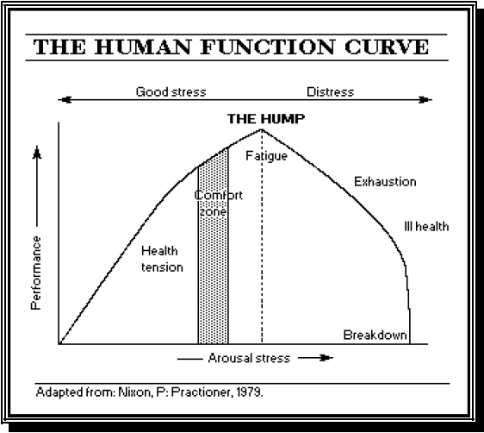
Human Function Curve in Average Provider/Staff
Four Levels of “Stress”
Fantasy
THE HUMP
Clinicians think they
are pushing to “HUMP”
as if Eustress
They don’t realize they are
actually pushing into
Distress(“overdraft”)
Eustress
Distress
Patient
in need!!
Acute and chronic
high level occupational stress.
Neurocognitive, physical, emotional changes. Burnout, Depression, Substance abuse.
Increasing risk of error, poor patient experience,
disruptive behavior.
Point A
Stretch
Hyperstress
Medical or
Psychiatric
Breakdown Medical Death or
Suicide²²
Boredom
Hypostress
Arousal stress, pressure, increased expectations on staff
Point A = even minimal
arousal can precipitate
breakdown
∞
Sources:
Patients as primary concern.
Multiple work stresses from uncoordinated sources
Each small alone but incrementally accumulate.
1 + 2 + 3 + 4 + 5 + 6……………………….
Stress
Figure 1. Adapted from: Nixon PGF. The Practitioner. (217):765-770. 1976²³
Shareholders as primary concern

Slide 9
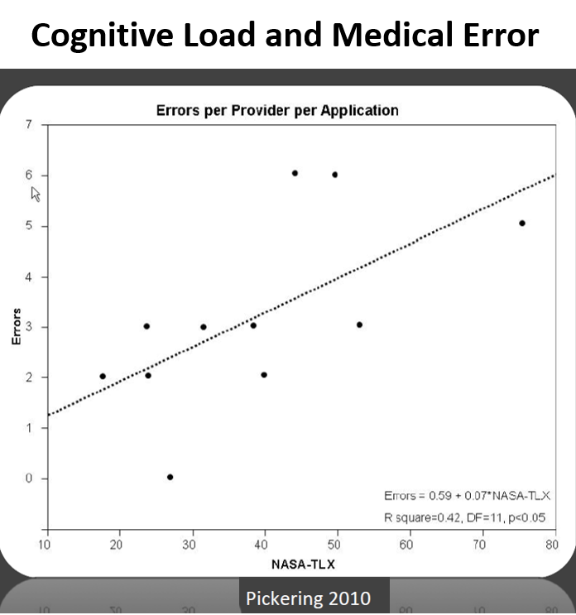
Cognitive Load and Medical Error
Even highly intelligent people can reach their cognitive load threshold very quickly, and your best staff can create medical error as a result.

Slide 10
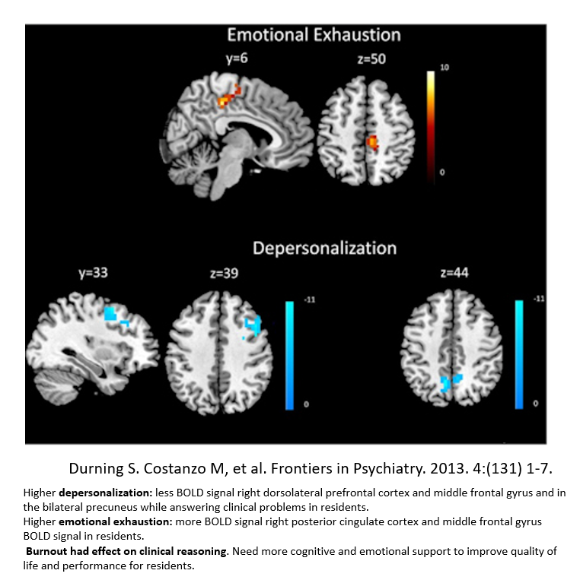
Burnout is Associated with Biologic Changes
Hormonal
Cortisol fluctuations (high then low over time)
Coronary artery plaques
Genetic
Telomere shortening (hastened cellular aging)
Neurochemical
Excess glutamate leading to decreased grey matter in basal ganglia (decreasing fine motor control)
Neuroanatomical
Thinning pre-frontal cortex (lowers attention span, poorer quality decision making)
Enlarged amygdala (increased reactivity to stress)
Hippocampal shrinking (memory reduction –
4-6 weeks daily high stress – spatial STM
≥ 12 weeks high stress- LTM & STM

Slide 11
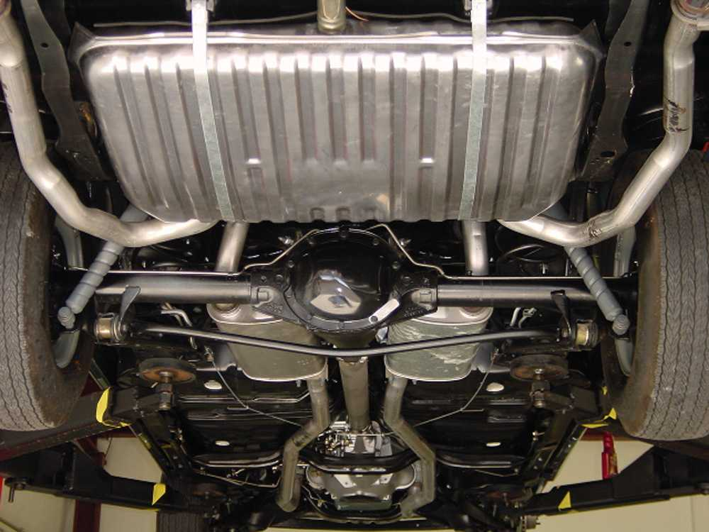
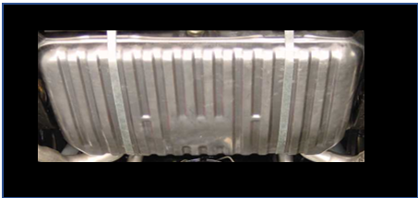
Chronic High Occupational Stress Condition at Work- Metaphor
Gas Tank
Gas Tank
Gas Tank Metaphor
Rested, fed, healthy human clinician.
Large Gas Tank filled:
Now to face high occupational stressor expectations.
Shrunken Gas Tank
Burned out, depressed, anxious, sleep deprived,
unfed human clinician.
Smaller capacity created by chronic wear-down.
Less brain resource to achieve same expectations. Starting out with less capacity yet to face high occupational stressor expectations.

Slide 12
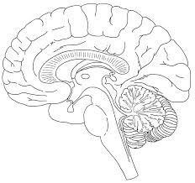
Cognition can be Automatic or Controlled
Automatic Thought (basal ganglia):
Also called System 1 Thinking, Habit Memory
Quick. Stimulus -> response.
Conserves resources, burning far less glucose.
Energetically far less ‘expensive’
Used when cognitive resources are low.
Controlled Thought (prefrontal cortex):
Also called System 2 Thinking, Executive Function, Cognitive Flexible Memory.
Used for high level function. Carefully think through diagnosis, differential diagnosis, weigh pros and cons of treatment, etc.
Uses up cognitive resources (glucose)
Limited and expensive neural resource
In dynamic, complex situations: Need controlled thought. Automatic thought may lead to error.
12

Slide 13
Cognitive Load Theory
Cognitive capacity
Demand exceeds available resources;
Errors increase greatly
Intrinsic load: Inherent level of cognitive effort for task
Germane load: Cognitive effort for making mental model into LTM
Extraneous load:
Cognitive effort that can be removed with better design
Mental Reserves
Healthy
Load
Intrinsic load: inherent level of cognitive effort for task
Germane load:
Cognitive effort for making mental model into LTM
Extraneous load: Cognitive effort that can
be removed with better design
Unsustainable
Load
Once cognitive capacity is reached: Brain is depleted of resources required
for controlled thought. Then automatic thought, load shedding and goal shielding occur.
Automatic thought- learned response from stimulus. No differential diagnosis
Load shedding- offload information, first low risk, then random shedding
Goal shielding- not allow new information into brain processing
13
Notes:
The more complex the task or goal, the lower the tolerance for extraneous load.

Slide 14
Root cause analyses show extraneous cognitive load accounts for 87.1% of medical errors
Causes of Medical Errors
Most safety interventions focus on training clinicians (but only 12.8% of causes)
Leadership has the potential to change a majority of system-level causes to improve
individual-level rates
Individual-level causes | % of Errors | System-level causes | % of Errors
Knowledge and skill | 12.8% | Structure (job design) | 12.2%
Attention on task | 14.5% | Culture (decisions and interactions) | 57.7%
Information processing | 6.1% | Process | 18.0%
Critical thinking | 34.3% | Policy and Protocol | 6.6%
Non-compliance | 26.5% | Technology and Environment | 5.6%
Normalized deviance | 5.7%
Directly caused by Cognitive Load
Indirectly Caused by Cognitive Load
Suggests a vast number of medical errors are preventable, given that extraneous load is inherently reducible. However, need shift of emphasis in patient safety efforts.
14
2018 HPI/Press Ganey

Slide 15
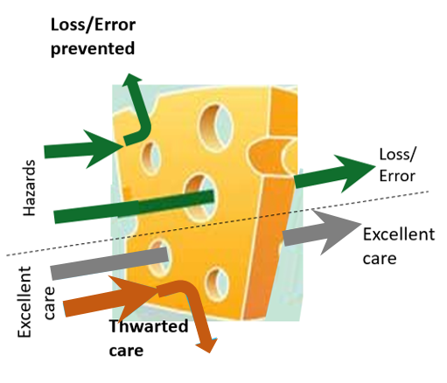
Usual model of error prevention: “Swiss Cheese Model” include a system of protective barriers. Goal: Reduce "holes” that prevent the barrier from being effective.
However, Swiss Cheese Layers (defense barriers) must be strategic and well designed.
Avoid non-strategic “layers” that may thwart what would have been excellent care.
15

Slide 16
Non-strategic defense barriers (thwarted care) increases cognitive load and causes incidents
Systemic Influences: Administrative Policy, Regulatory Bodies, Hospital Infrastructure
POTENTIAL
CARE QUALITY
Cognitive
Deterioration (CD)
POOR CARE
AVERAGE CARE
EXCELLENT CARE
CARE DELIVERY ISSUES
CD
CD
Thwarted Care
Thwarted Care
Thwarted Care
BARRIERS TO CARE
Provision of Care
BARRIERS TO CARE
Provision of Care
BARRIERS TO CARE
Provision of Care
ACTUAL
CARE QUALITY
GOOD CATCHES &
NEAR MISSES
POOR CARE
AVERAGE CARE
EXCELLENT CARE
DEFENSE
BARRIERS
INCIDENT
Privitera M, MacNamee K. Physician Leadership Journal May/June 2021 p 39-46
16

Slide 17
Mitigable environmental/systemic factors, cognitive decline, and decreased quality of care
Mitigable Negative Environmental Factors
Thwarted Care
High Workload*
Lack of
Cognitive
Restoration
Untested
Metrics and Requirements
Cognitive Threats to Wellbeing
Negative Outcomes due to Poor Wellbeing
Moments of Protection from Error
Acute Stress
High Cognitive Load
For Clinicians
Poor Medical Device Design
Cognitive effects
Chronic Stress
Reduced Cognitive Capacity
Tractable effects
DEFENSE
BARRIERS
Cognitive Deterioration
Medical
Errors
Good Catches & Near Misses
Decreased
Patient Care
Quality
*Workload: physical, cognitive,
and emotional
17
Privitera M, MacNamee K.
Physician Leadership Journal May/June 2021 p 39-46

Slide 18
Interventions
Need both individual and organizational interventions.
Human Factors/Ergonomics (HFE) basic concepts for use at leadership level
HFE: Tools to mitigate and prevent latent medical error and clinician burnout
Builds upon existing strategies with science to inform action.

Slide 19
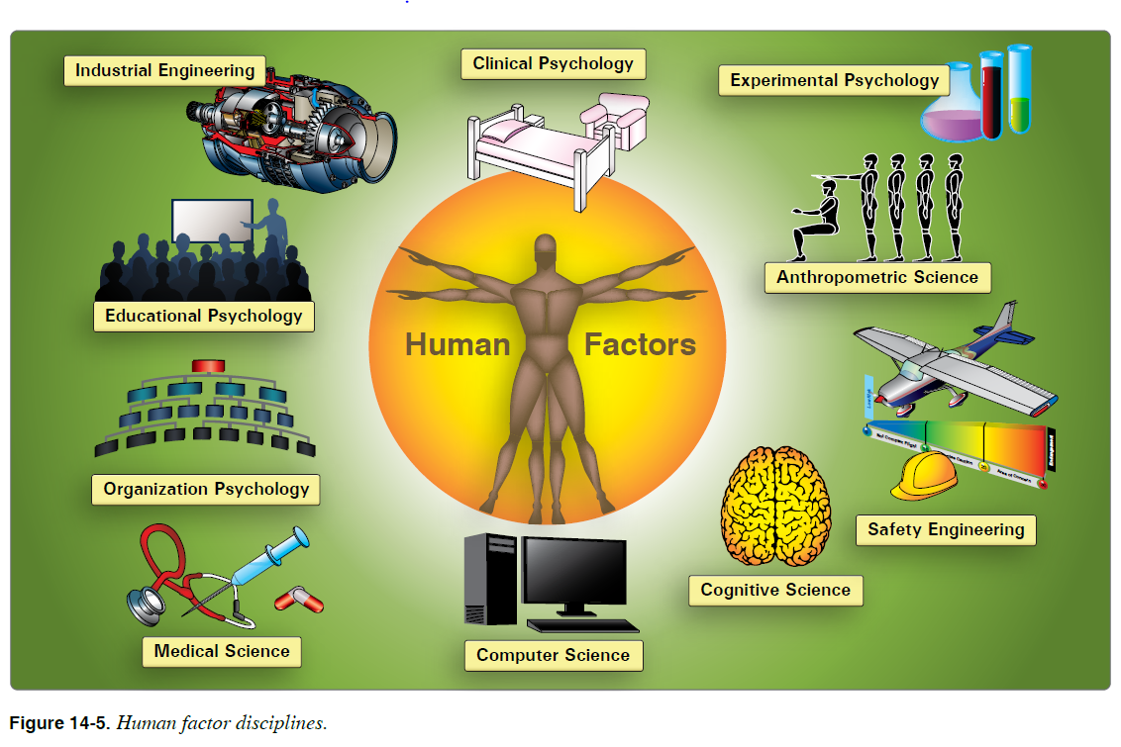
What Are Human Factors / Ergonomics (HFE)?
HFE Definition: The scientific discipline concerned with the understanding of interactions among humans and other elements of a system.
3 Major Types of Ergonomics:
Physical Ergonomics
Organizational Ergonomics
Cognitive Ergonomics
Applies theory, principles, data, and methods to design in order to:
Optimize human well-being and
overall system performance.
Patient safety is a component of
system performance.
Goal:
Fit the system to the people
instead of
fitting people to the system
https://www.faasafety.gov/files/gslac/courses/content/258/1097/AMT_Handbook_Addendum_Human_Factors.pdf
Chapter 14 Human Factors FAA Safety
International Ergonomics Association www.iea.cc
19

Slide 20
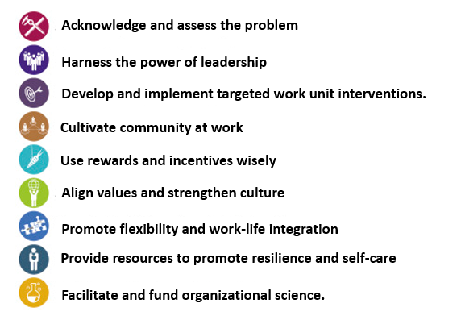
Executive Leadership and Nine Organizational Steps to Promote Engagement and Reduce Burnout
Human Factors/ Ergonomics (HFE) can be
applied at all steps of over-arching framework
Awareness. Assessment framework for areas of overwhelm and human limitation.
Legitimizing problem. Aligning all leaders. Set culture and messaging. Strategic presence at key times.
Assessment and implementation assisted by knowledge
of basic HFE. Apply methods to reduce extraneous cognitive load (ECL) and other drivers of burnout
Collaboration of leaders, clinicians and staff working together to improve comradery and work environment.
Recognize effect of financial incentives on burnout.
Enhance autonomy, mastery and purpose.
Engage efforts in quality of care, system efficiency and clinician wellbeing
Integrate concepts of long term organizational benefits from improved clinician wellbeing, retention, and recruitment.
Individually and organizationally initiated
Organizational science needed even more now with technology acceleration faster than human adaptation.
Tait D Shanafelt MD and John H. Noseworthy MD, CEO of Mayo Clinic .Mayo Clinic Proc. 2016

Slide 21
Initial Steps in Wellness Program
Overview of design
Two types of coping utilized
Primary Coping— fix the problems causing stress
Secondary Coping— ways to adjust to remaining situational stress
Interventions
Individual- multiple- such as mindfulness based practice, 3 good things, gratefulness journaling, etc. Wellness seminars 11/year. Count for Continuing Education(CE) and malpractice reduction
Organizational- bottom up or top down, but combination best as participatory management.
New leadership skills needed to work with work environment of high stress, rapid change, information overload, increasing expectations (Human Factor Based Leadership)
New organizational structures to collect and process input from those closest to the problems (clinicians)
Wellness Strategic Planning Work Group (WSPWG)-clinicians and administration.
Senior Leadership- needed in beginning and strategic times.
Harness power of leadership
Brief presentation on issues involved in burnout, help align
understanding, language, awareness of consequences of no action.
Assessment
Leader’s cover letter to survey: “Commitment to action” and encourage honesty.
Validated tool if measure burnout. However, most useful data will be write in responses. Ask for two answers for each:
What gives most meaning in work?
What are major stressors ?
What are reasonable suggestions?
First information must be anonymous answers
Share aggregate data findings to constituents to demonstrate
transparency and enhance trust
Open Forum: After aggregate data, can present in open forum and get
more input utilizing “Vegas rules”:
a. Forgive hierarchy relationships.
b. What happens in Vegas stays in Vegas,
c. One can later say what was discussed but not trace back to
person who said it.
WSPWG is ongoing organizational structure to address work/life
integration, solve hospital level organizational issues.
Departments have Wellness Representatives.
Impact vs. Feasibility study helps to prioritize order of interventions.
Light blue: Contact MRP if
more information desired
21

Slide 22
Individual-based Interventions
Encourage recognition of Burnout in the face of Medical Culture of Endurance and Silence
Paired with organizational interventions
Wellness Seminar Series as ‘safe place’, and good way to get started in organization.
Add in organizational structures and interventions
Avoid blaming the victim
Normalize self care
Normalize boundaries between work and home despite technology—by policy and/or culture
Multiple individual interventions available:
Mindfulness-based stress reduction
Resiliency training- realizing that they started out as a highly resilient group
Gratefulness
3 Good Things
Yoga
Coaching
Employee Assistance- Wellness Division
Self Help websites and literature
Peer Support program
Clinician ombudsman to have work/life balance representation
Diet, exercise

Slide 23
4th Aim =Experience of Providing Care
(Application of Human Factors and Ergonomics in Provision of Care)
National, State, Local, and Industry
Requirements
Conventional Thinking*
Administration
Quality & safety | Finance Compliance | Risk Management | Billing | Health Info Management | Educational Mandatories | Medical Staff Office
“Keep lights on”
“Must comply to survive”
Implementation: Where healthcare administration has options / control
Integrative thinking*
in implementation
Clinician input and collaboration
Work Environment
Clinician input and collaboration
Healing and Safety Environment
Clinician
Patient and Family
Clinical Team
Conventional Thinking: Make “either-or” choices; settle for best available options provided. * Martin R. HBR 2007
Integrative Thinking: Creatively resolve tensions among opposing ideas: generate innovative outcomes. New idea may have elements of each, but is superior to the original options. *Martin R HBR 2007
+
=

Slide 24
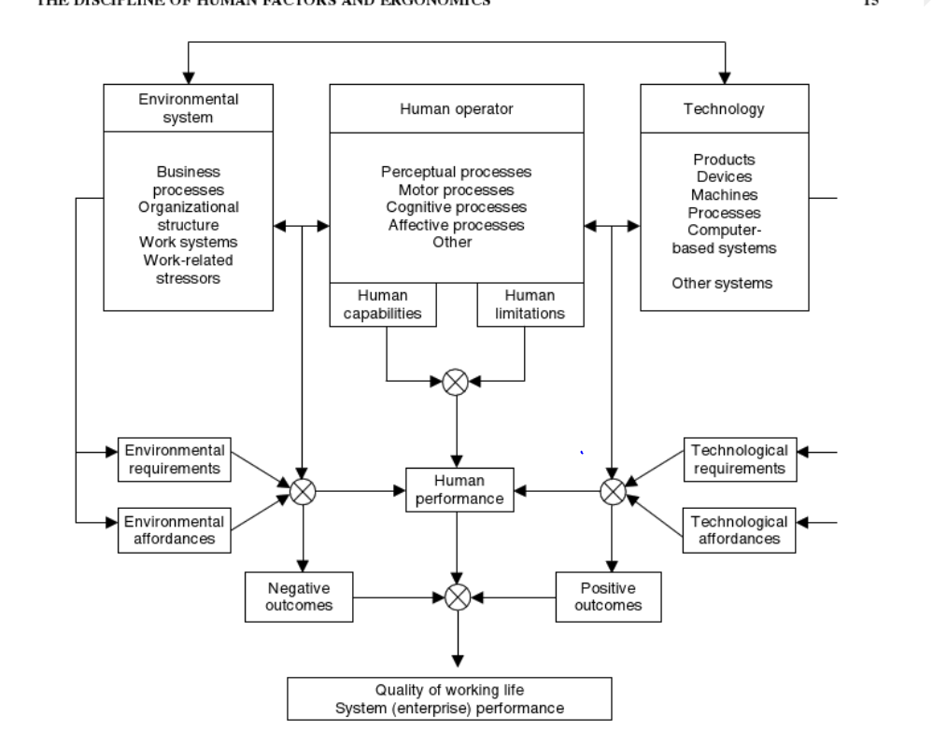
Human-Organizational System Ergonomic Approach
Environmental
System
(Human) Clinicians
Technology
Insufficiently appreciated
In healthcare delivery
Human
Performance
in
patient care
Adapted from Karwowski 2005

Slide 25
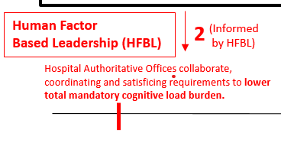
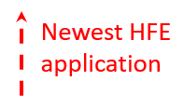
Human Factors/ Ergonomics (HFE) Spectrum of Applications
National, State, Industry
Regulatory, Mandates, Laws, Requirements.
Multiple vendors of education and technology
to achieve, monitor compliance.
2
Influencers of Clinical Performance
Hospital System
Mitigate or Amplify many externally imposed expectations on clinicians.
Ambient Induced
Endogenous
Hospital: Senior, Mid-Level Leaders & Managers
Clinical Situation induced
Each Hospital Authoritative Office independently sends out its requirements
1
(Business as usual}
2
Provider
Procedures
Patient
2
2
Accident
analysis
2
Peripherals
Products
Policy
Upstream

Slide 26
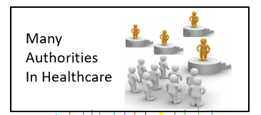
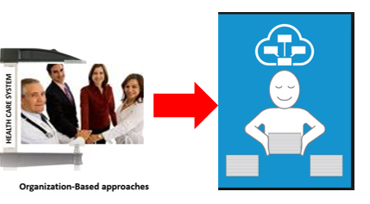
Healthcare Ecosystem
Well-intended
EMR- not well designed.
Multiple Quality Metrics
Patient Safety Movement.
Mandatory education initiatives
Patients as primary concern
Not so well-intended
Hassle Factors by Insurance
intended to wear down clinician,
For-profit Agendas.
Healthcare as investment vehicle.
Shareholders as primary concern
Macro Level-
National, state,
industry, regulatory
Administrative Task demands:
Mandatories, policies, laws, regulations,
quality metrics, billing, prior auth’s,
work flow issues, EMR software
Meso Level-
Hospital/
Healthcare
Organization
Hospital
Leader
Pathway
Business as Usual
1
Apply HFE
Human Factor Based Leadership
Programs to
Reduce Extraneous
Cognitive Load
Work outside of Work minimized. Off time protected. Physical emotional and cognitive restoration.

Slide 27
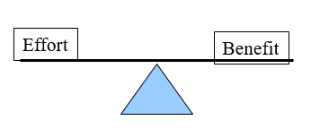
Satisficing*
A foundation of economics and human productive behavior
Combination of “satisfactory” + “sufficient”
Acknowledges real world limitations of resources
Within the context of limited resource of money, time,
brain power available, and other workload expected.
Important concept when organizationally managing requirements, trainings mandatories, etc.
*Coined by Herbert Simon (1916-2001): Nobel Prize winner and one of the founders
of fields of organization theory and information processing

Slide 28
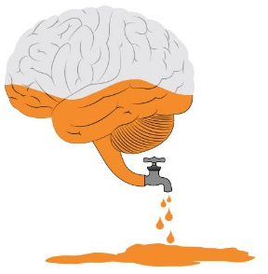
Controlled Thought- Brain Resource: Used Up in These Processes
Focusing of attention
Decision making (no matter the size of decision)- EMR clicks matter
Sorting, classifying
Multitasking, getting back on track after interruption.
Re-routing or switching from one mental task to another.
Maintenance of goals
Maintenance of information active in working memory
Updating working memory
Self-regulation: professionalism, self-effacement despite how treated,
Maintaining “Aequinimitas” in setting of bleeding, injury, pain, etc.
Emotion work: dealing with bad outcomes, distressed patients and families

Slide 29
Broad-Stroke Interventions to Reduce Extraneous Cognitive Load (ECL)
Evaluate processes and metrics currently in place-
Are they strategic? ( why?)
Are they necessary? (why?)
What might be the unintended consequences?
In the context of meeting requirements, is there a better way that is not as cognitively expensive- to not drain highly trained time and brain resource?
Standardization
What are the core operational issues to standardize and promote routines vs. when should you allow and encourage autonomy, customization?
When might standardization jeopardize safety or a patient’s unique needs? Is there a “wiggle room” option built in?
Consolidate information.
Reduce split attention effect. Bring data together needed for workflows.
Process coupling.
Decrease redundancy
In communication of data and design
Prioritize Design –
Procure equipment and implement layouts with deliberate designs that consider Human Factors/Ergonomics (HFE).
Anticipate situations of clinician low cognitive resource in design:
Burnout, high stress
High volume demand
Evening or night shift, extended work hours
Sleep and food deprivation
Collaborate
With leaders from areas of the hospital system who also roll out requirements and work expectations
Find opportunities to lower cognitive load by means of the collaboration.
with Human Factors professionals. Hire them at your institution.
Adapted and expanded from Elizabeth Harry MD. Steps Forward AMA Webinar 3/2/21.
“Cognitive workload: a modifiable contributor to physician burnout ?”
29

Slide 30
Split attention principle
Multiple sources of information, distributed either in space or time can create problems with comprehension and learning, causing higher extraneous cognitive load.
Try to integrate into one source of information in same physical space or closer in time.
Space (spatial split attention)—
Going between information sources A and B if separated in space. It requires more brain power and is harder to learn information compared to A and B being integrated into same physical space.
Time (temporal split attention)—
Temporally contiguous sources of related information between A and B, are affected by information decay of A information over the time. If too far apart in time, harder to associate A and B as a unit to get coded into long term memory.

Slide 31
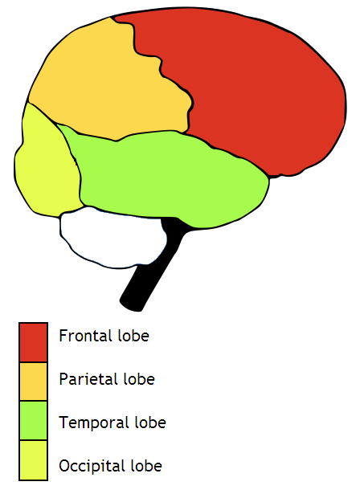
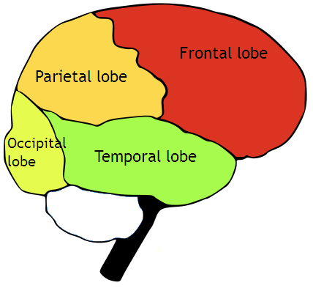
Reducing Spatial Split Attention
Which requires less total cognitive load to understand?

Slide 32
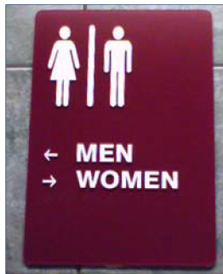
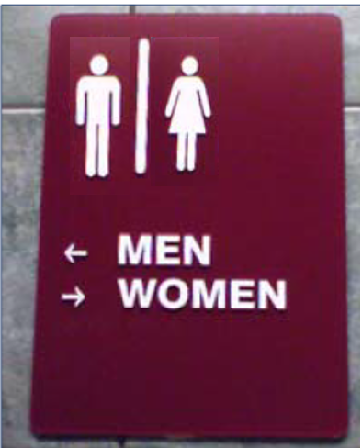
Reducing Spatial Split Attention
Which requires less total cognitive load to understand?
A
B

Slide 33
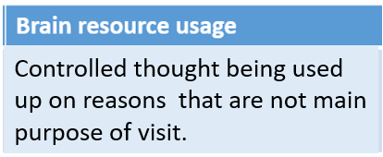
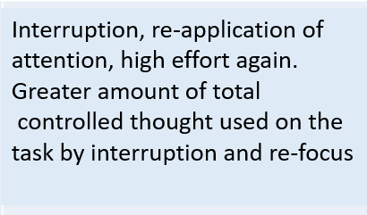
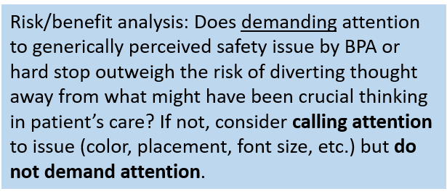
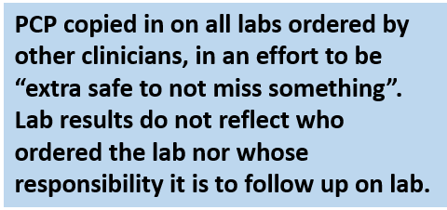
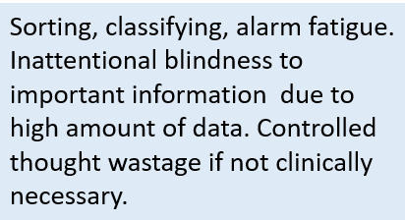
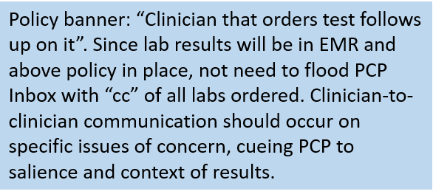
Leadership Application of HFE to Reduce Extraneous Cognitive Load (I)

Slide 34
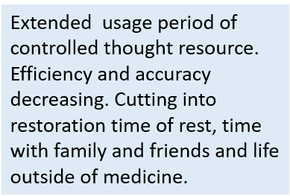
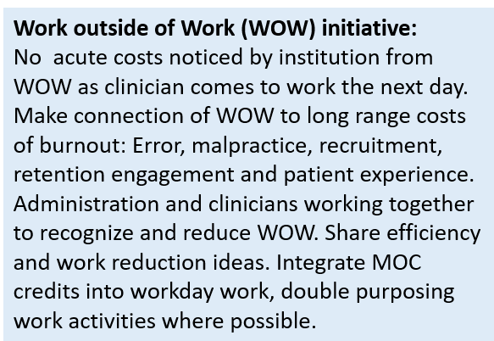
Leadership Application of HFE to Reduce Extraneous Cognitive Load (II)

Slide 35
Summary of Key Leadership New Material
1. Optimal workloads: Cognitive load, emotional load and physical load.
2. Optimal use of brain power resource applied to job–
cognitive and organizational ergonomics
3. Look beyond Time on (FTE) as below.
4. Firmly preserve Employee Time off / human needs / restoration / boundary between
work and home
Need policy & culture supportive.
Excessive “Free labor” will bite you later
Must find better way to get all requirements of the job done at work.
5. Be aware of “shadow work” (hidden work needing to be done that is off metrics)
6. Be aware of pain points and affective (emotional) responses that can
affect brain power and quality of decisions.
7. Apply cognitive/ ergonomic principles to IT interface design,
workflows, and leadership
8. Work at top of license- budget controlled thought for best competency of
clinician decision making.

Slide 36
Thank you !
Michael R Privitera MD MS
Medical Director, Medical Faculty and
Clinician Wellness Program
Michael_Privitera@urmc.Rochester.edu
Website: www.MichaelRPriviteraMD.com

Slide 37
Case Walk-Through of Burnout and Error: How can we help this system of care?
Clinician
High stress environment
Burned out.
Given 15-20 min for
new patient complaint.
Patient
Resulting
treatment:
Sleep medication, with refills.
Low sodium diet
Return visit in 6 months for full physical.
What was missed:
Differential dx of insomnia.
He had Major Depressive Disorder of 4 months duration.
Had suicidal ideation, intent and plan to kill himself.
Depression caused poor functioning.
About to loose his job.
Chronicity of Depression increasing risk of stroke and heart disease, especially as smoker.
Regulatory demands inserted into visit without more resources:
Counsel on stopping smoking,
Meaningful use criteria checked and reviewed
New patient history form
Populate problem list
Cover alcohol and drug use
Immunization
Preventive measures
Send for old record.
Patient Assessment
Clinician brain operating with diminished controlled thought resource
Therefore converts to automatic thought:
Hyper focus one symptom
Load shedding of other data
Goal shield against other new data
More vulnerable to cognitive bias, harder to overcome.
Stimulus = insomnia (picked out this one symptom).
Automatic response = insomnia treatment
60 y.o. male smoker
new patient.
Complaints of:
insomnia,
headache,
fatigue
BP 148/92 P= 96

