Slide 1
Empowering Leaders:
Transforming Workplace Culture to Support Healthcare Worker Well-being
Christi Corriveau, MD MEd
Co- Chair, Clinician Well-being
Children’s National Hospital
Notes:
Good Morning Everyone
I am so happy to be spending the next hour with you talking about ways to effect change that can lead to improvements in the lives of healthcare workers in your organization
Share with you some of the literature and programs that have been demonstrated to show benefit and create change

Slide 2
Learning Objectives
Review systems-level drivers of professional well-being among healthcare workers.
Reflect on the impact of organizational culture on the professional well-being of healthcare workers.
Define Wellness-Centered Leadership.
Discuss how optimal leadership behaviors impact team performance and well-being.
Apply wellness centered leadership skills to drive change and improve your organizational culture of well-being.

Slide 3
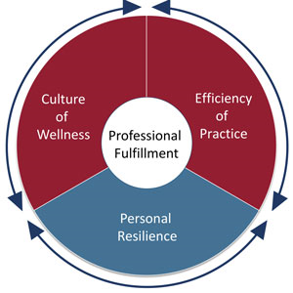
Well-being: Individuals + Systems
Culture of Wellness: Work environment that promotes self care, personal and professional growth, and compassion for colleagues, patients, and self
Efficiency of Practice =
Value added clinical work accomplished
Time and Energy spent
Personal Resilience: Individual skills, behaviors, and attitudes that contribute to personal physical, emotional, and social well-being
©2016 Stanford Medicine
Bohman B, Drybe L. Sinskey C et al. NEJM Catal.2017
Notes:
RECOGNIZING THE ISSUES OF THE CULTURE OF OUR PROFESSION, WE DON’T PRACTICE IN A BUBBLE
There are aspects of institutional culture and practice-based and healthcare system-based inefficiencies which get in our way
The aim is to go beyond reducing burnout to increasing professional fulfillment—to create the organization environment that allows clinicians to thrive.
What organizational and individual strategies shown to foster joy, purpose, and meaning and reduce burnout??

Slide 4
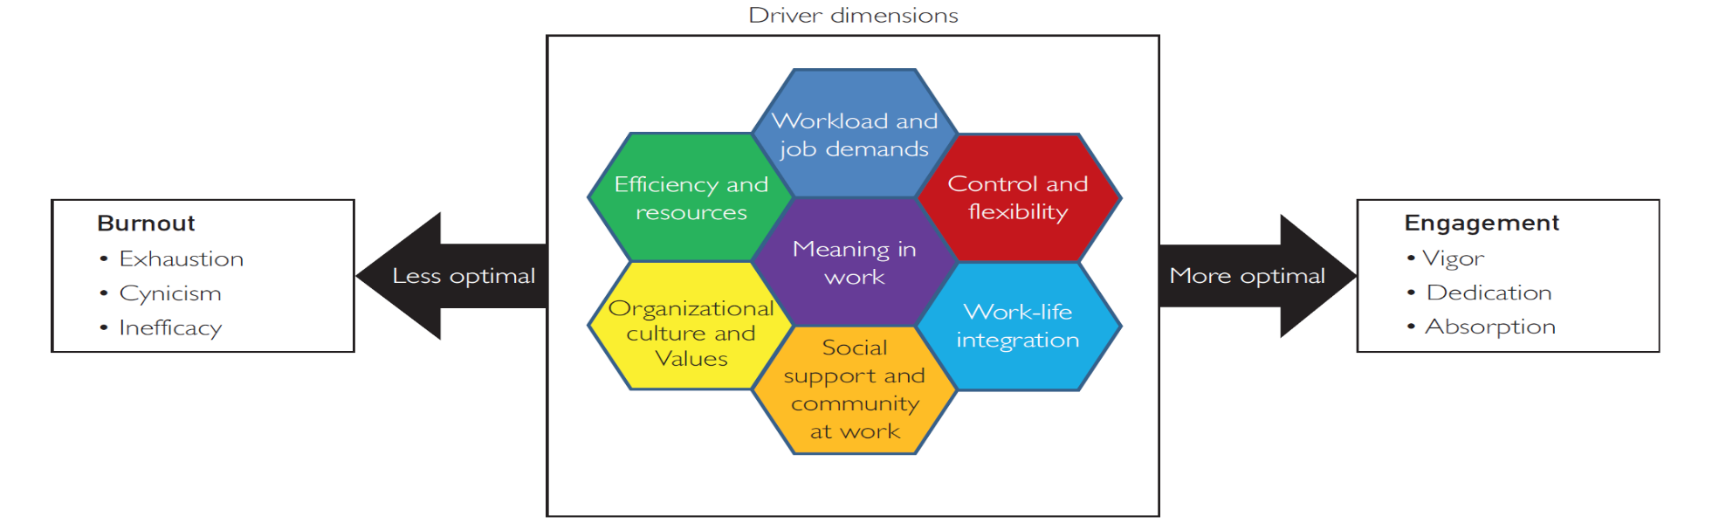
What drives Engagement vs. Burnout?
Workflow Inefficiencies (EHR)
Increased time spent documenting
High or New Workloads
Loss of Control Over Work Environment
Loss of distinction and conflict between work and life
Culture Shift from Health Values to Corporate Values
Loss of Meaning at Work
Social Isolation at Work
Shanafelt TD, Noseworthy JH. Mayo Clin Proc. 2017;92(1):129-146.
Notes:
CC
Threats to Well-being for HCWs during COVID-19:
Trauma
Fear for personal and family safety
Balancing family and childcare/educational responsibilities
Social isolation
New and different workloads (adult patient care)
Worry of job insecurity/financial loss

Slide 5
Culture refers to the shared and
fundamental beliefs, normative values, and
related social practices of a group that are
so widely accepted that they are implicit
and no longer scrutinized.
Professional Culture
Organizational Culture
Sub-cultures
Shanafelt et al, Mayo Clin Proceedings. 2019.
Notes:
The definition
The organizational, professional level culture, and sub-cultures such as units or areas of practice

Slide 6
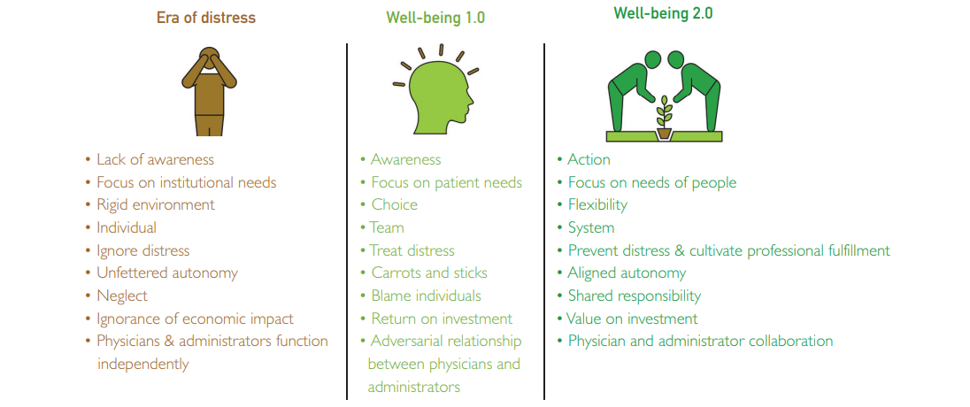
Organizational Characteristics
Well-being 2.0
Shanafelt T. Mayo Clin Proceedings. Oct 2021
Notes:
How has healthcare organizational culture changed and impacted healthcare workers over time
Ideal state (2.0); Engaged workforce; high quality leadership is critical to employee engagement

Slide 7
Leadership
Notes:
So how do we get to the 2.0 future state?
How do healthcare organizations create the positive changes needed to turn around the current challenges we are faced with ?
LEADERSHIP

Slide 8
Leadership is…..
“Leadership is a process hereby an individual influences a group of individuals to achieve a common goal”
PG Northouse. Leadership: Theory and Practice. 8th edition, 2018 Sage Pub, Thousand Oaks, CA
Notes:
Definition that we commonly use
Speaks to leadership as a process
Individual (s) influence others to achieve a common goal (s)

Slide 9
Why Leadership Skills and Behaviors Matter… and How They Determine Organizational Culture
Health care workers are largely employed by healthcare systems, often in large integrated systems
This evolution has led to decrease autonomy and loss of control over their work
Loss of purpose and meaning in work
Misalignment between employed healthcare staff professional values and organizational strategy
Notes:
Leadership behaviors matter
Healthcare workers need the support and direction to make positive changes- status quo won’t be sustainable
The healthcare profession and healthcare organizations need to re-assess how things are done to meet the needs of our patients and of those who support the organization- the healthcare workers

Slide 10
Leadership Theories
Leadership is something you are “born with”
Style Leadership Theory
Situational Leadership Theory
Transformational Leadership
Wellness Centered Leadership

Slide 11
What is Wellness-Centered Leadership?
Integrative model of leadership proposed by Shanafelt et al 2021*
Designed to cultivate leadership behaviors that promote engagement and professional fulfillment
3 elements
  Care about people always
  Cultivate individual and team relationships
  Inspire change
*Shanafelt T et al. Acad Med 2021;96:641-651

Slide 12
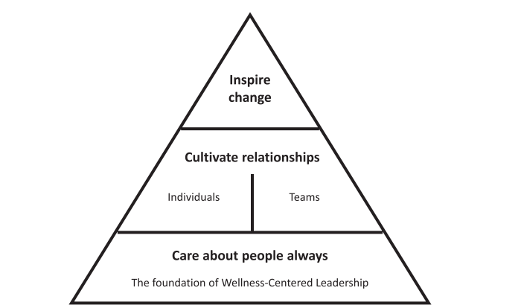

Slide 13
Self-Care : Leaders Model the Way
Self-care is critical to optimal performance
Exercise, nutrition, rest from work(vacation, breaks) and sleep*
Leader’s level of burnout, professional fulfilment and self-valuation predicts their independently rated leadership behavior score**
*van Dam N et al. Harvard Business Review https://hbr.org/2016/02/theres-a-proven-link-between-effective- leadership-and getitng-enough-sleep.
**Trockel MT et al. Mayo Clin Proc.,2019;94:2022-2031
Notes:
Self-care and self-valuation key
Leadership behavior assessment impacted

Slide 14
The Impact of Leadership on Team Performance and Fulfillment
Leadership behaviors of supervisors significantly impact burnout and satisfaction
Every one-point increase in leadership score for physician’s immediate supervisor =
  3.5%  burnout
  9.1%  in physician satisfaction
-Holds career development conversations with me
-Treats me with respect and dignity
-Inspires me to do my best
-Encourages me to develop my talents
-Encourages employees to suggest ideas for improvement
-Empowers me to do my job
-Provides helpful feedback/coaching
-Is interested in my opinion
-Recognizes me for a job well done
-Keeps me informed of changes
Shanafelt TD, Gorringe G, Menaker R, et al. Mayo Clin Proc. 2015;90(4):432-440.
Notes:
Mayo Clinic Participatory Management Leadership Index
This instrument was designed to evaluate dimensions of leadership that drive engagement and discretionary effort among team members. The original 12-item instrument was subsequently revised to a 9-item instrument as previously reported.17 Each item is scored on a 5-point Likert scale (1 = strongly agree; 5 = strongly agree) and scores are summed to yield a total score. The aggregate leadership behavior score for each leader is calculated by the composite evaluations of all responding physicians they supervise

Slide 16
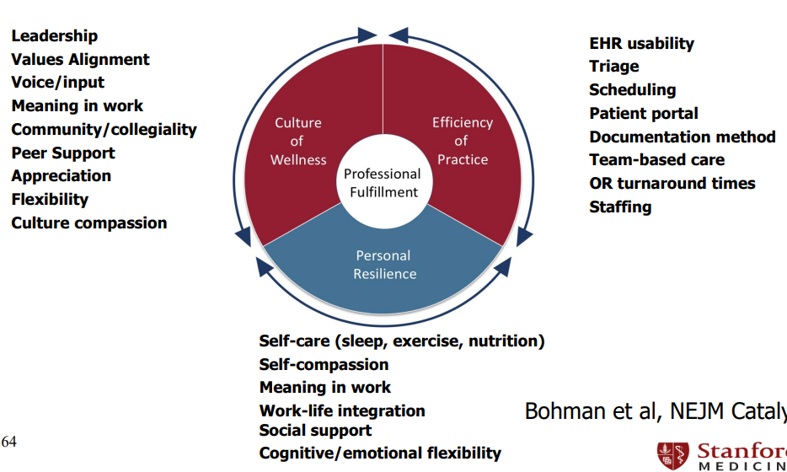
Well-being: 20% Individuals + 80% Systems
Bohman et al, NEJM Catalyst 2016
Notes:
HS

Slide 17
Case Study: New Clinic Site
Behavioral Health Service line – New off campus location, 2 miles from main hospital
Collective healthcare team is unhappy despite free parking, large beautiful clinical space, multiple allied health partners on site, and good restaurants /metro next door
Call-outs are increasing creating additional stress on team members at work
2 senior clinicians are considering changing to part-time status, hard to fill vacant team openings
Overall productivity and revenues are down from prior, pre-move financial quarter
Patient satisfaction scores are ☹ or 😐
You have your weekly team meeting this afternoon to discuss
Notes:
Apply one of the evidence based approached using
Caring about people, always and helping people work together to find solutions

Slide 18
Building Professional Joy in your Practice….
From the Ground Up
Sustainability
Rapid Iterative Experimentation
Cultural Transformation
Foundational Programs
Safety Net Resources for Distressed Clinicians | Group- or issue-specific Resources | Self-care and wellness promotion | Leadership Development | Collegiality and Community | Assessment of Well-being | “Pebbles in the Shoe”
Shanafelt T, Stolz S, Springer J, et al. NEJM Catalyst. Nov-Dec 2020

Slide 19
Pebbles in the Shoe
Removal of sources of frustration and inefficiency
Requires partnership between leaders and healthcare professionals
Ask
Listen
Empower
Repeat
*Swenson Sj, Shanafelt TD. Mayo Clinic Strategies to Reduce Burnout: 12 Actions to Create and Ideal Workplace. New York, NY Oxford University Press; 2020.
Notes:
Swenson and Shanafelt- Mayo
Create Agency for your team to help fix the issue
Partnership: Empower HCW to develop and implement solutions
Select leaders on the team to get the project done; establish this as pat of the leadership development process ; coach, action learning, mentoring, assessment, feedback
Resource the effort to help them, continue with leadership development
Repeat: commit to a process of continuous improvement; revisit with original focus groups, work on the next steps
ID champions to help partner and get work done
Esprit de corps

Slide 20

Foster Community
Connection with colleagues – COMPASS Mayo Clinic
  Small group of physicians meet for dinner once every 2 weeks (cost covered by Mayo
  First 20 minutes discuss the virtues and challenges of being a physician
  Clinical trial showed improvement in meaning and burnout; rolled out to all faculty
Shanafelt TD, Noseworthy JH. Mayo Clin Proc. 2017;92(1):129-146

Slide 21
Mental Health Support
Normalize conversations around mental health needs
Peer Support
Stress First Aid
Schwartz Center Rounds
Flexible offerings; need more than EAP
Notes:
We need to acknowledge that the work we all do is hard and the past several years has particularly challenging for all
Create a Safe Culture to speak openly and seek the help/support needed
Leaders should model supportive behaviors to their teams; it’s OK to not be OK and here is how we are going to help
Culture of caring and inclusion for all employees; looking out for each other and identifying distress and need

Slide 22
SKY Breath Workshop: Virtual Implementation as part of
Pandemic Response
In Spring and Summer 2020, as a rapid response to the pandemic, Children’s National approached the Art of Living Foundation’s Healing Breaths Program to offer virtual workshops to its healthcare professionals.
Overwhelming Response: 287 CNH HCPs participated in a total of 9 workshops offered over 3 time periods
Workshop Logistics:
  - 2.5-hour session/day over 3 consecutive days
  - 100% virtual conducted online via Zoom
  - Taught by trained instructors from Art of Living Foundation

Slide 23
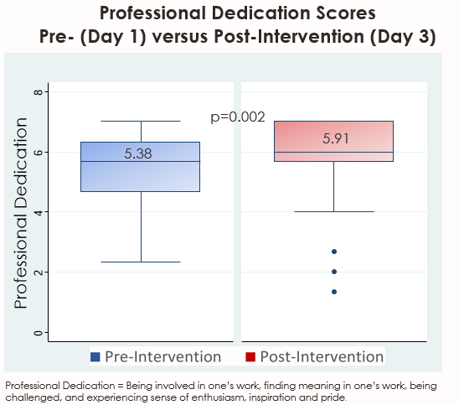
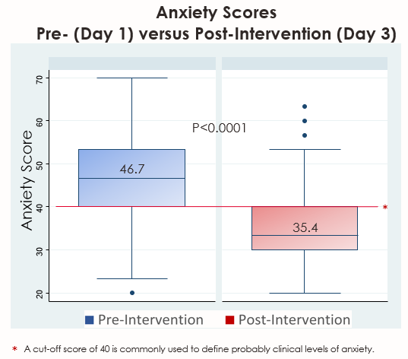
Virtual SKY Workshops: Key Outcomes

Slide 24
Cultural Transformation
Gratitude for Institution
Connection and Cohesion
Self-care for Leaders
“The most important thing is that investment from our employer to offer this to us especially during this time of the pandemic – to really care about our health, wanting us to be present and to be there for our patients.”
Torin Creppy, President, Safe Kids Worldwide
“I have worked as a nurse at Children’s for over 30 years, and I have never felt as connected to my colleagues as after this course.”
Kathy Dubois, MSN, RN, NPD-BC, HEC
“We invest so much into our work at Children’s National, and to be having this opportunity that’s invested in us to make sure that we’re doing well, is such a huge opportunity and I am very thankful for that. I really do recommend our executive leaders and others to definitely participate in this.”
Desiree de la Torre, Director, Community Affairs & Pop. Health

Slide 25
Measure Well-Being
Professional Fulfillment Index (Stanford)
Mayo Well-Being Index
Mini-Z _{2.0}
Maslach Burnout Inventory
  Emotional Exhaustion
  Depersonalization and cynicism
  Inefficiency and lack of personal achievement
Compendium of Key Resources for Improving Clinician Well-Being - National Academy of Medicine (nam.edu)
Wright et al. N Engl J Med 2018; 379: 309-311

Slide 26
Building Professional Joy in your Practice….
From the Ground Up
Sustainability
Rapid Iterative Experimentation
Cultural Transformation
Foundational Programs
Safety Net Resources for Distressed Clinicians | Group- or issue-specific Resources | Self-care and wellness promotion | Leadership Development | Collegiality and Community | Assessment of Well-being | “Pebbles in the Shoe”
Shanafelt T, Stolz S, Springer J, et al. NEJM Catalyst. Nov-Dec 2020

Slide 27
Well-being: 20% Individuals + 80% Systems
Bohman et al, NEJM Catalyst 2016

Slide 28
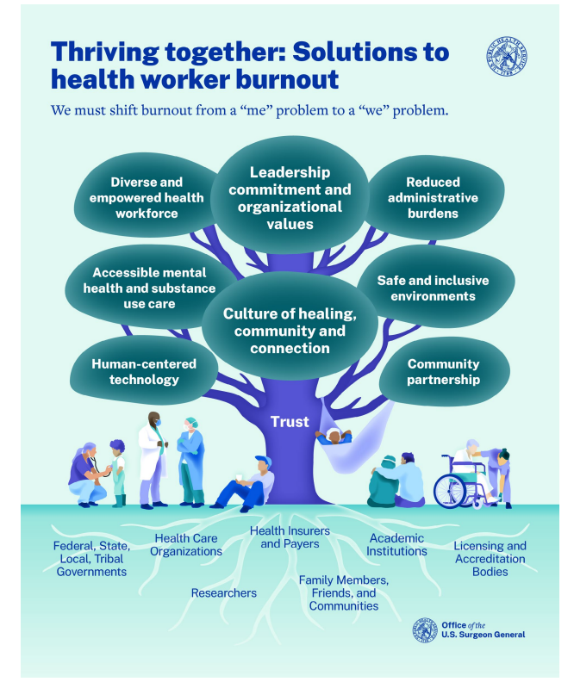
https://www.hhs.gov/surgeongeneral/priorities/health-worker-burnout/index.html
Notes:
Surgeon General’s Advisory released May 2022

Slide 29
Thank You!!
My thanks to my fantastic partners at Children’s National
Dr Hemant Sharma, MD, MHS Co-Chair, Clinician Well –Being
Ms. Gitanjali Persaud, Program Manager
Questions?? Ideas??
Email ccorrive@childrensnational.org or providerwellbeing@childrensnational.org

