Slide 1

What Do Physicians Want from Leadership?:
Insights from a Qualitative Four-City Study of Systems Factors in Occupational Health and Wellbeing
During COVID-19
Nancy Berlinger, PhD, Research Scholar
The Hastings Center
Co-Investigator, STEPPS
www.steppsmed.com

Slide 2
Acknowledgments
This research is supported by grants from the Greenwall Foundation, the National Institute for Occupational Safety and Health, and the Department of Social Medicine at UNC-Chapel Hill.
We are grateful to the physicians who took the time to share their experiences with us.

Slide 3
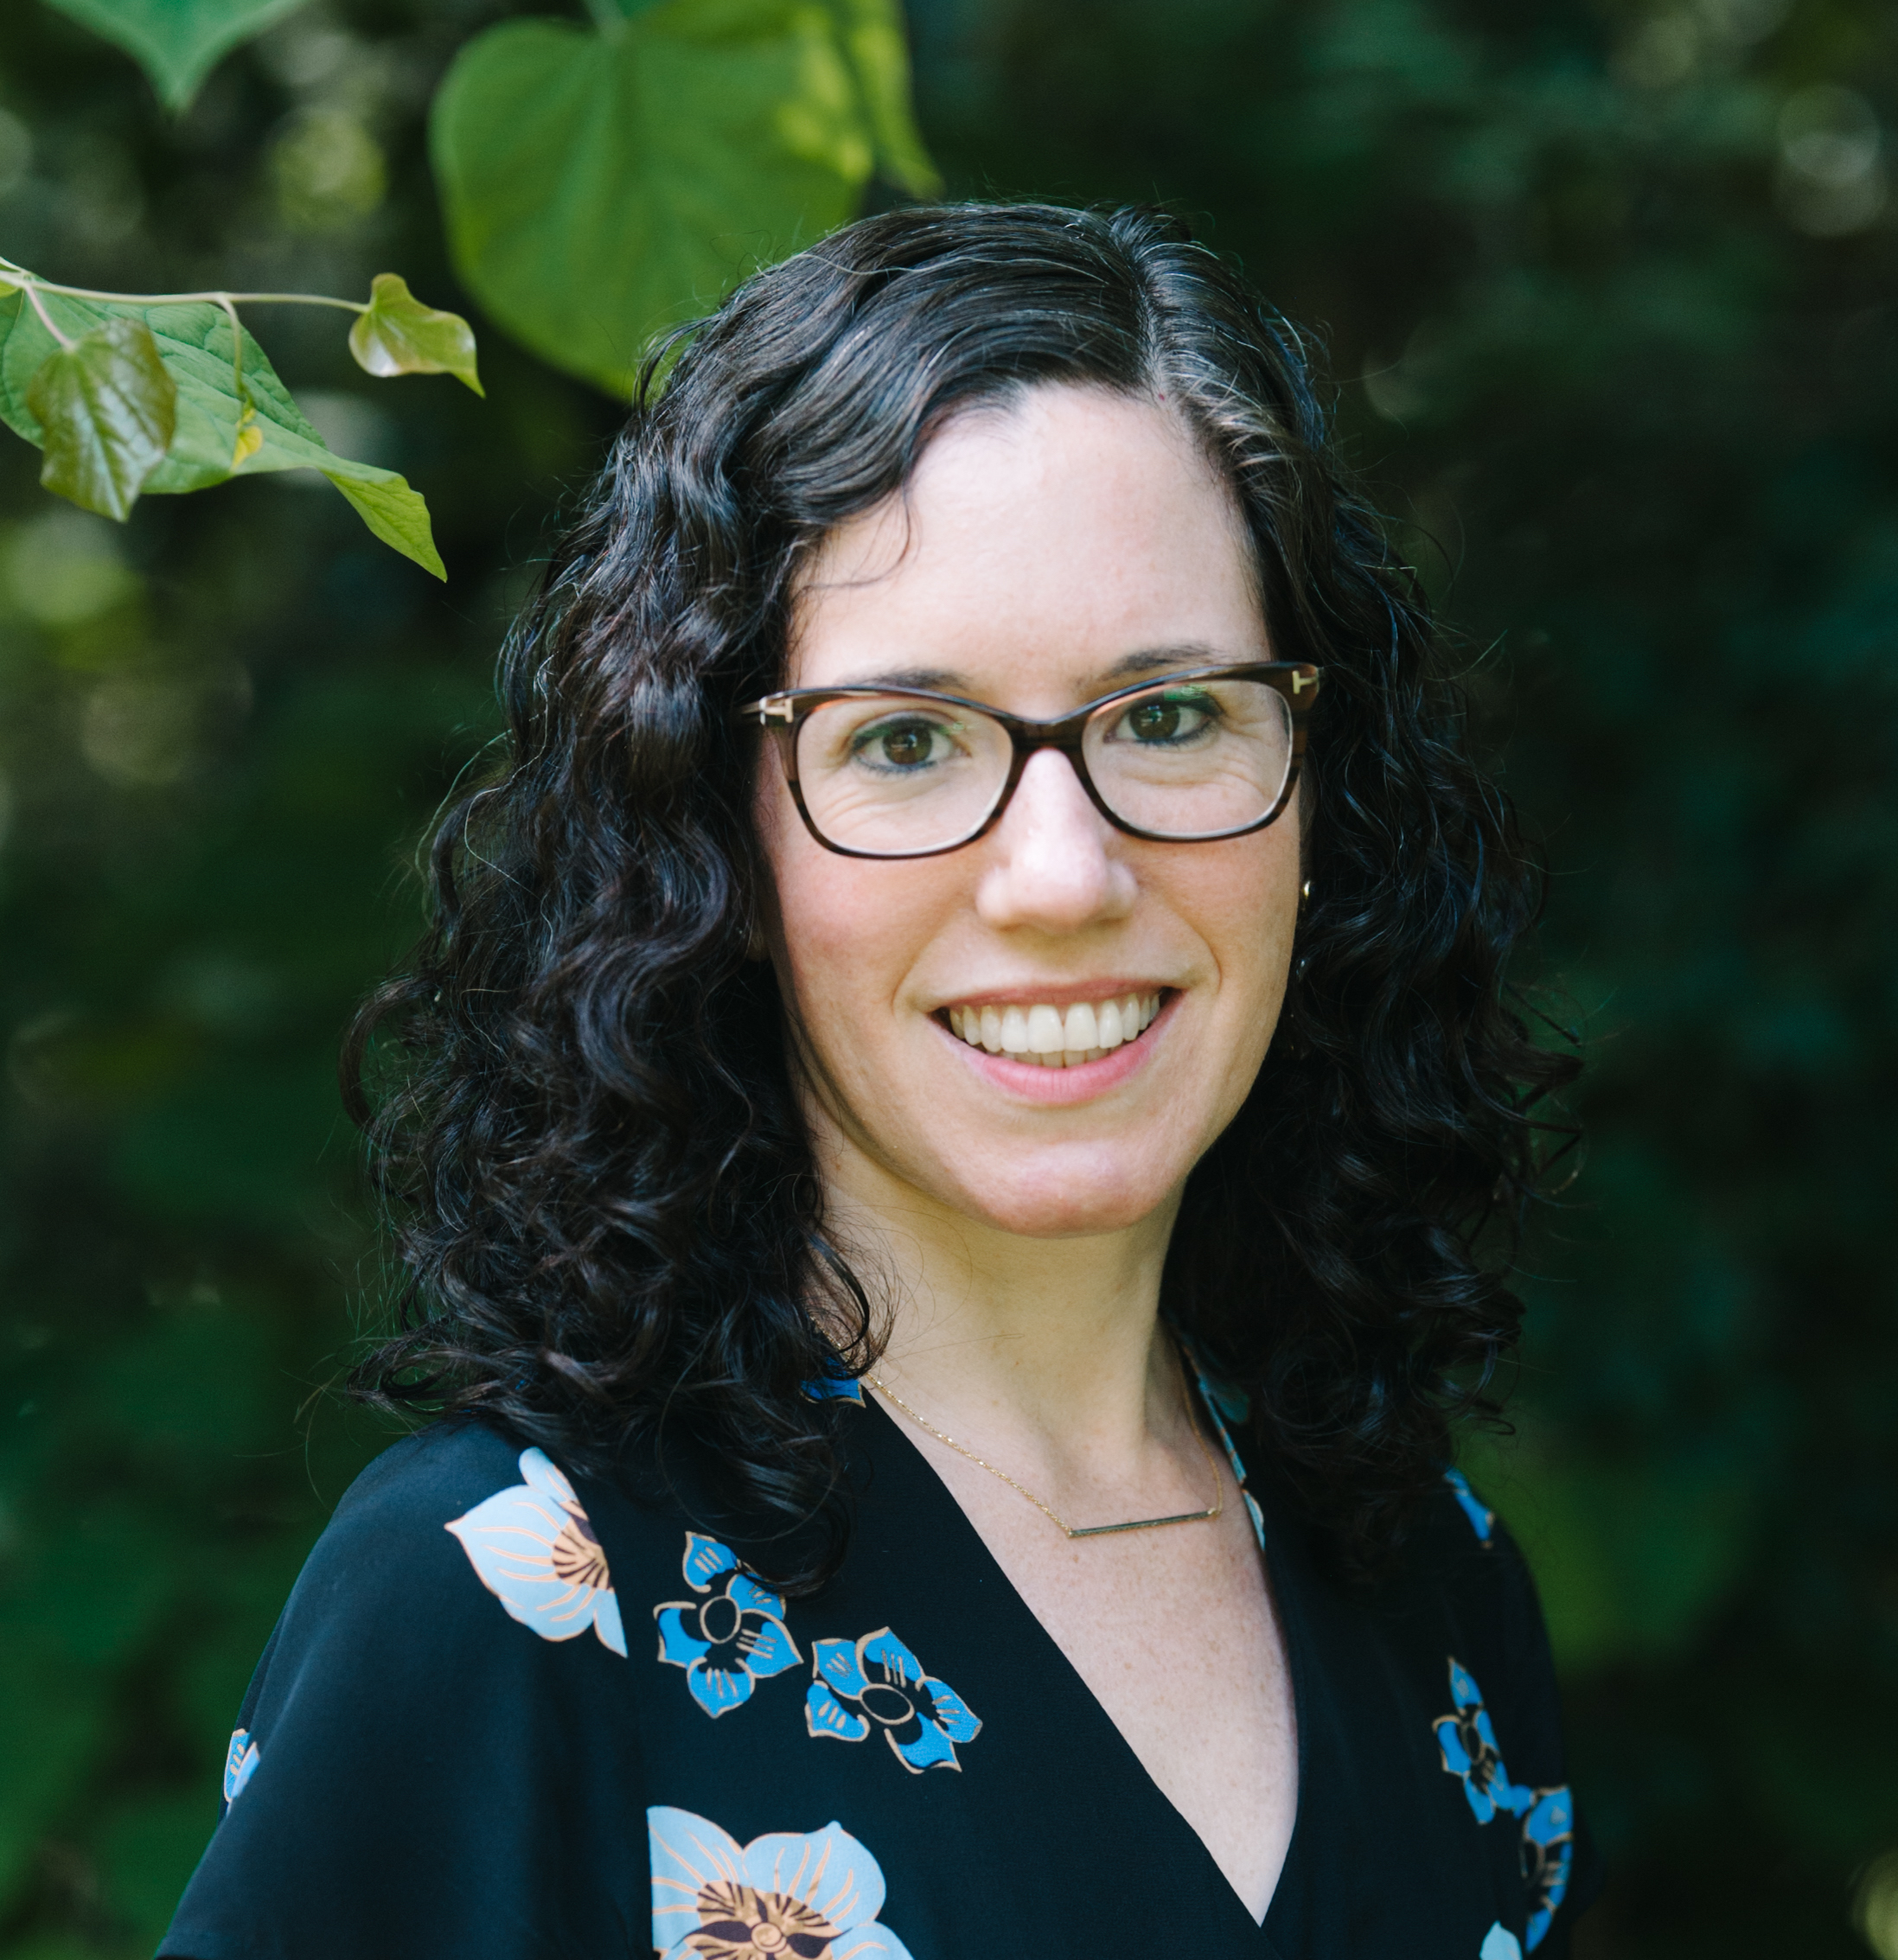
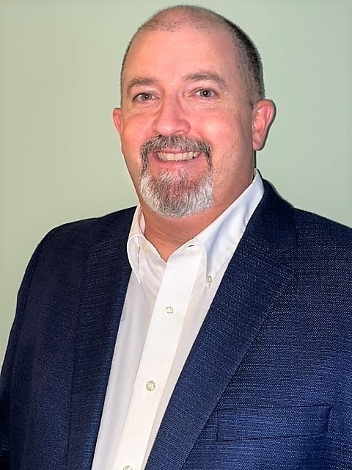


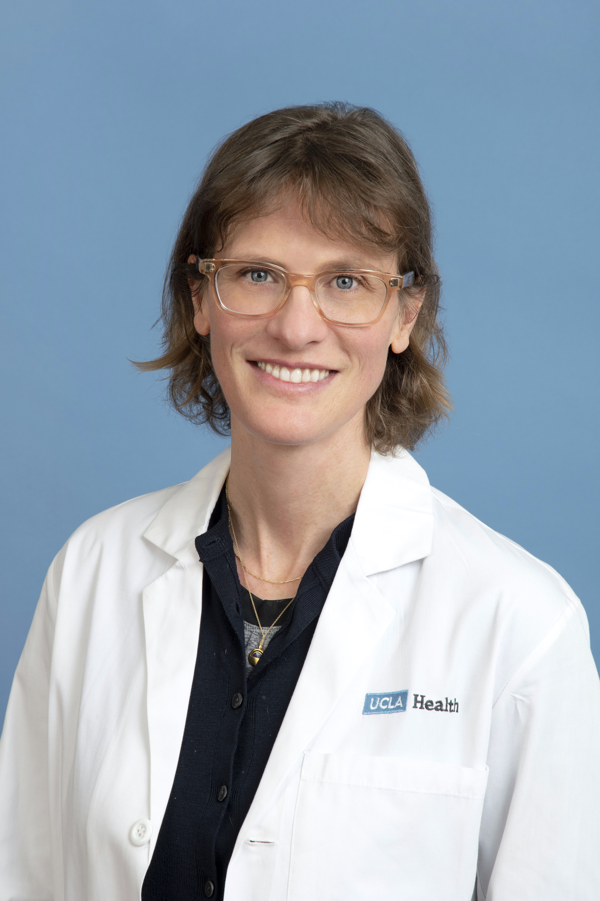
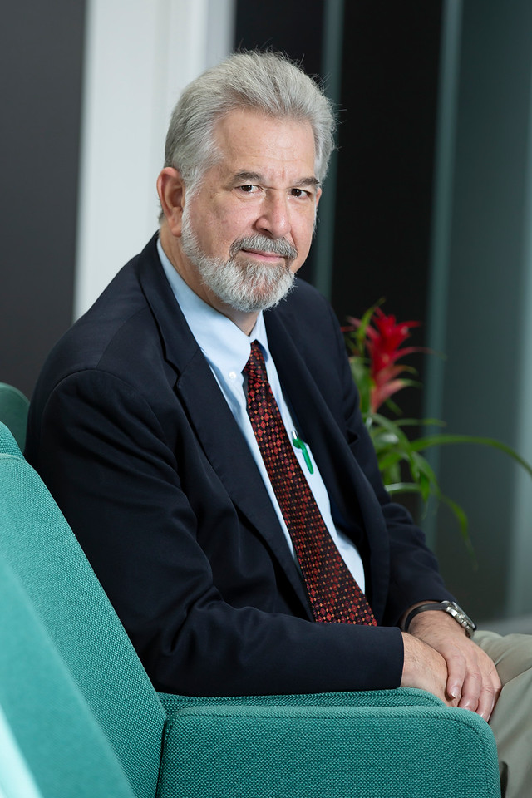
The Team
Mara Buchbinder, UNC, PI
John Staley, UNC, Co-I
Tania Jenkins, UNC, Co-I
Alyssa Browne, UNC, RA
Liza Buchbinder, UCLA,
consultant
Ken Goodman, U of Miami
consultant
Notes:
Team is led by social scientists who study health care practice and systems and includes experts in medical ethics and in occupational health.

Slide 4
Why we did this study
Physicians are at high risk for occupational stress and burnout (Shanafelt et al. 2012; Shanafelt et al. 2014).
Interventions targeting physicians’ individual resilience have consistently fallen short (West et al. 2020; Panagioti et al. 2017).
COVID-19 has made things worse:
            76% of US healthcare workers reported burnout in September 2020 (up to 30-54% in 2019) (NIHCM Foundation 2021).
            Physicians globally have reported increased levels of depression, anxiety, and PTSD (Vilovic et al, 2021; ACEP 2021; Greenberg et al. 2021; many more studies with similar findings)
Researchers are calling for systems-based approaches -- beyond individual “heal thyself” interventions – to prevent or mitigate foreseeable occupational stress (NAM 2019; Goroll 2020; Carayon et al. 2019; Sinsky et al. 2020; Vercio et al. 2021)

Slide 5


Study To Examine Physicians’ Pandemic Stress
Aim 1: Describe the relationships among the societal-, institutional-, professional-, and individual-level factors shaping workplace conditions during the COVID-19 pandemic and physicians’ perceptions of occupational health and wellbeing.
Aim 2: Identify systems, professional, institutional, and individual level characteristics that protect physicians’ occupational health and wellbeing during the COVID-19 pandemic.
Aim 3: Develop and disseminate evidence-based recommendations to protect physicians’ occupational health and wellbeing during normal and crisis conditions, with expert panel input.
Aim 1: Describe the relationships among the societal-, institutional-, professional-, and individual-level factors shaping physicians’ perceptions of moral stress during the COVID-19 pandemic, including and beyond initial outbreaks.
Aim 2: Assemble a conceptual framework that maps sources of moral stress for physicians.
Aim 3: Develop and disseminate evidence-based recommendations, with expert panel input, to respond to moral stress in physicians and safeguard their personal and professional integrity during pandemic response and beyond.

Slide 6

Research Design and Methods
Comparative study of physicians (attending or fellows) caring for hospitalized COVID-19 patients in 4 American cities, from a range of specialties and hospital types.
Methods: qualitative, semi-structured interviews conducted over Zoom lasting 60-90 min each.
Question domains:
(1) Personal background (2) Onset of the COVID-19 crisis (3) Institutional practices and policies (4) Working during the pandemic (5) Personal wellbeing during the pandemic

Slide 7
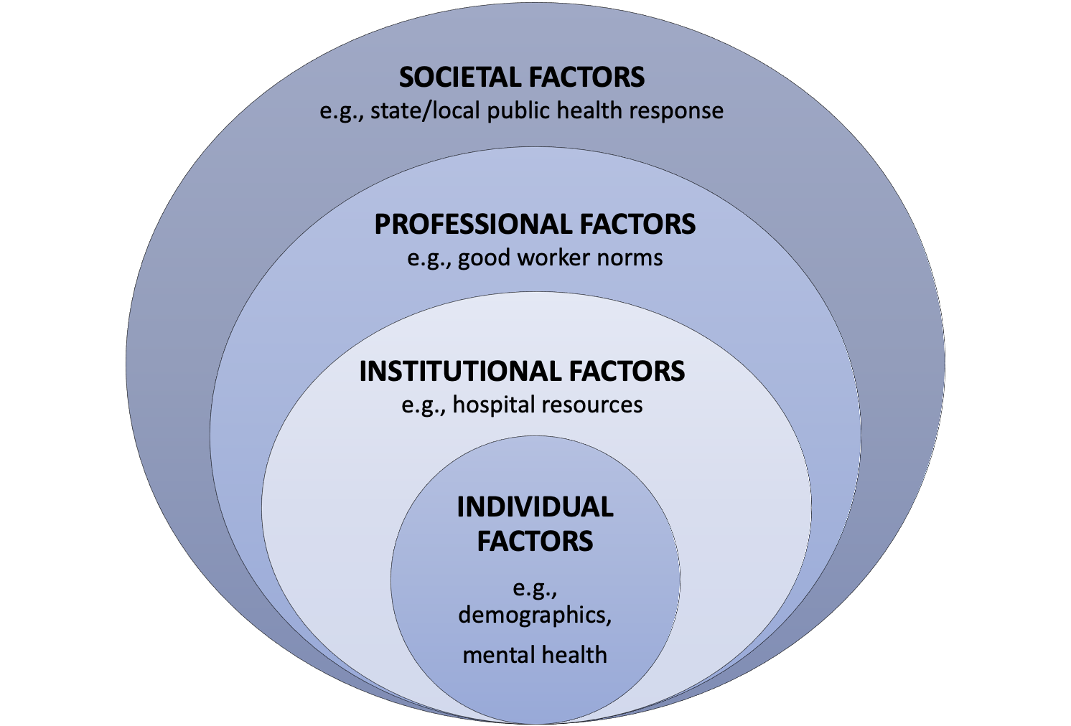
Conceptual Model

Slide 8
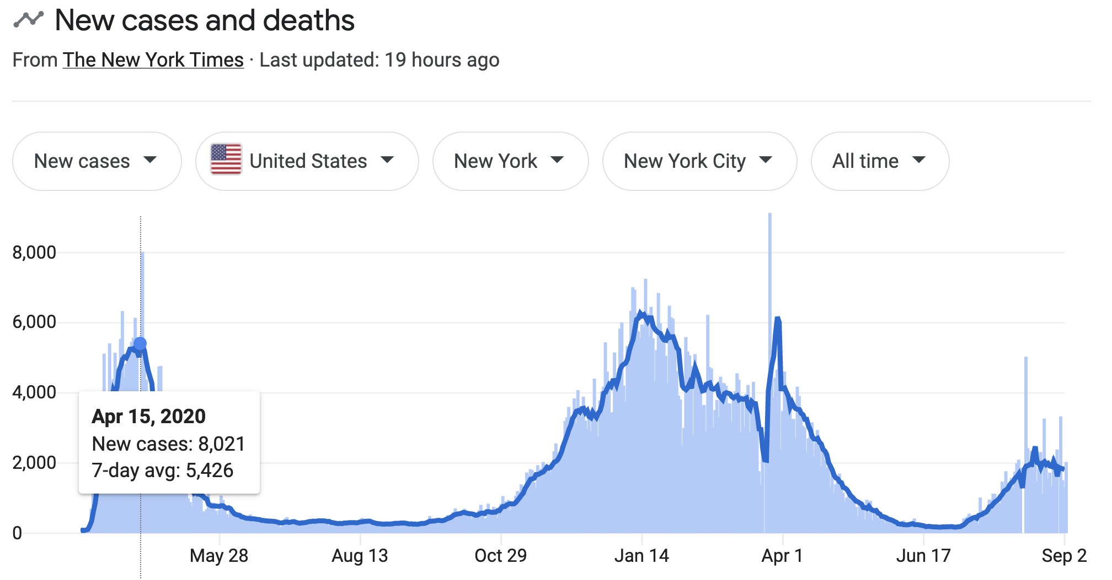
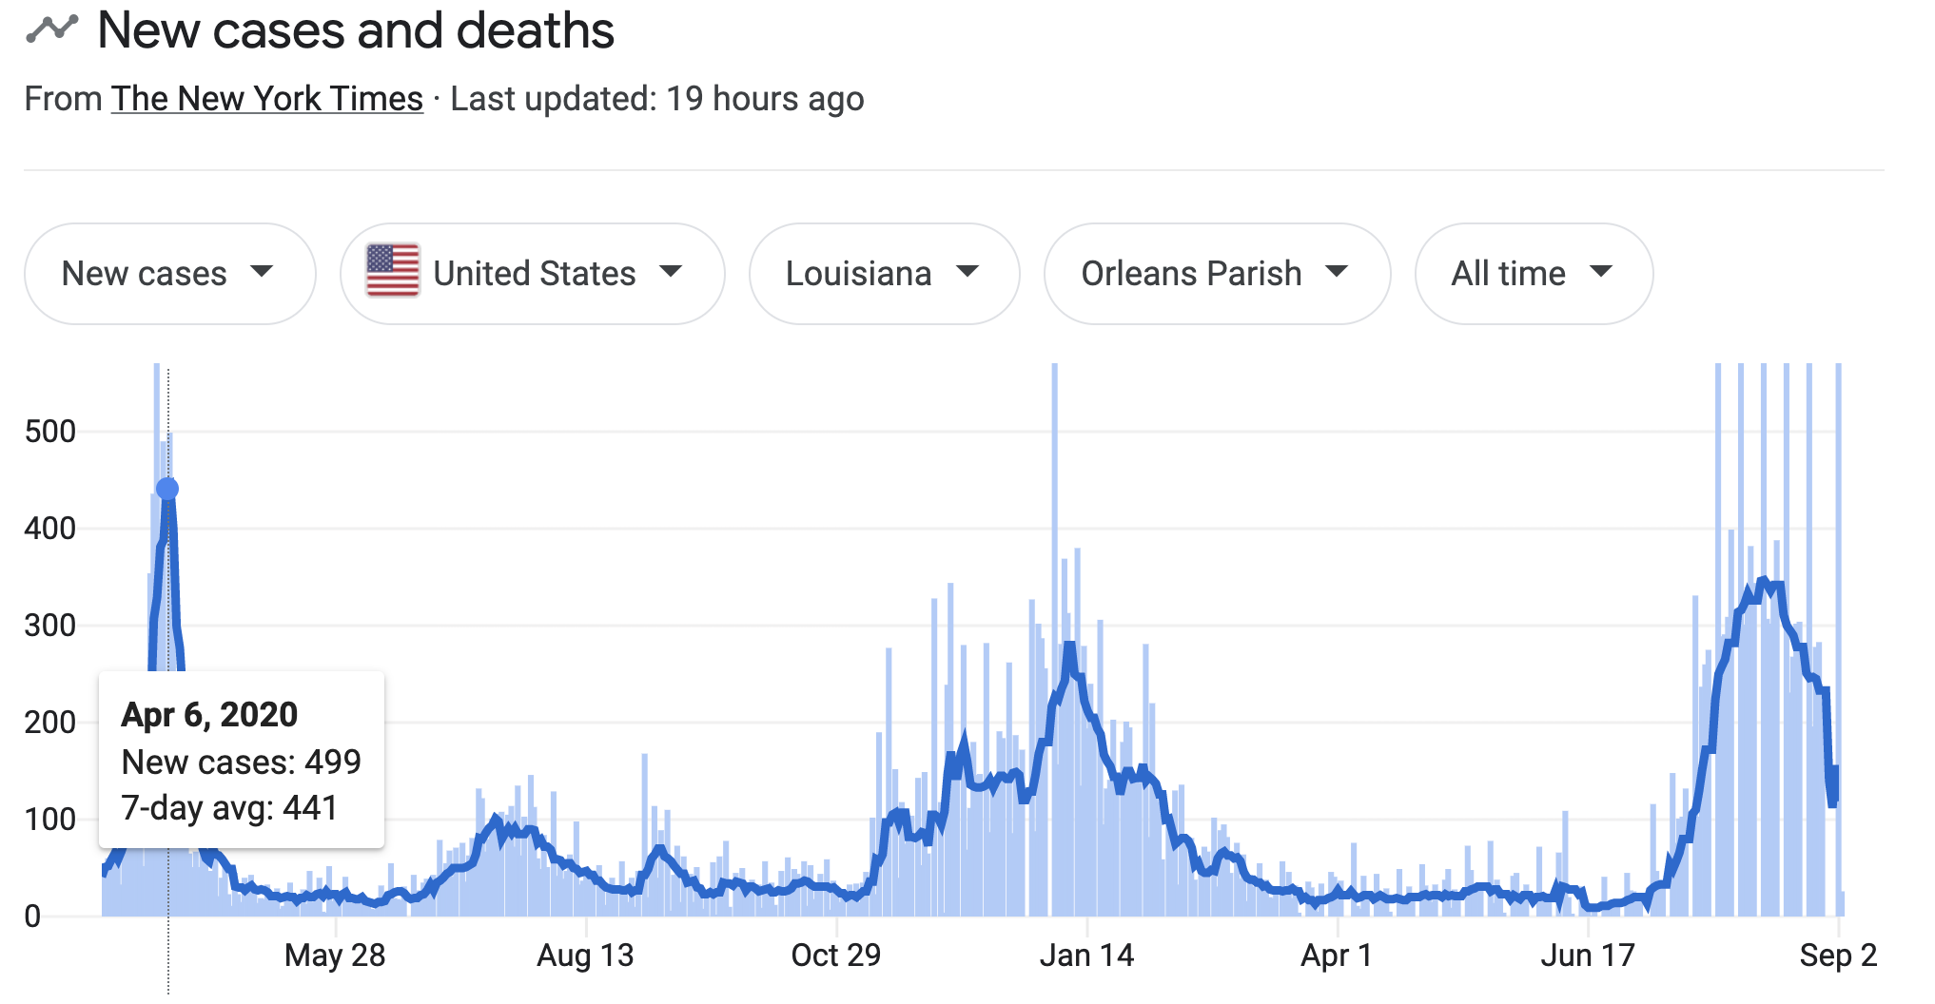
Selection of Cities: Greenwall
Interviews completed
Feb 2021-July 2021.
New York, NY
NYC and NOLA experienced initial surge conditions at roughly the same time, peaking in early to mid April 2020.
Interviews completed
May 2021-October 2021.
New Orleans, LA

Slide 9
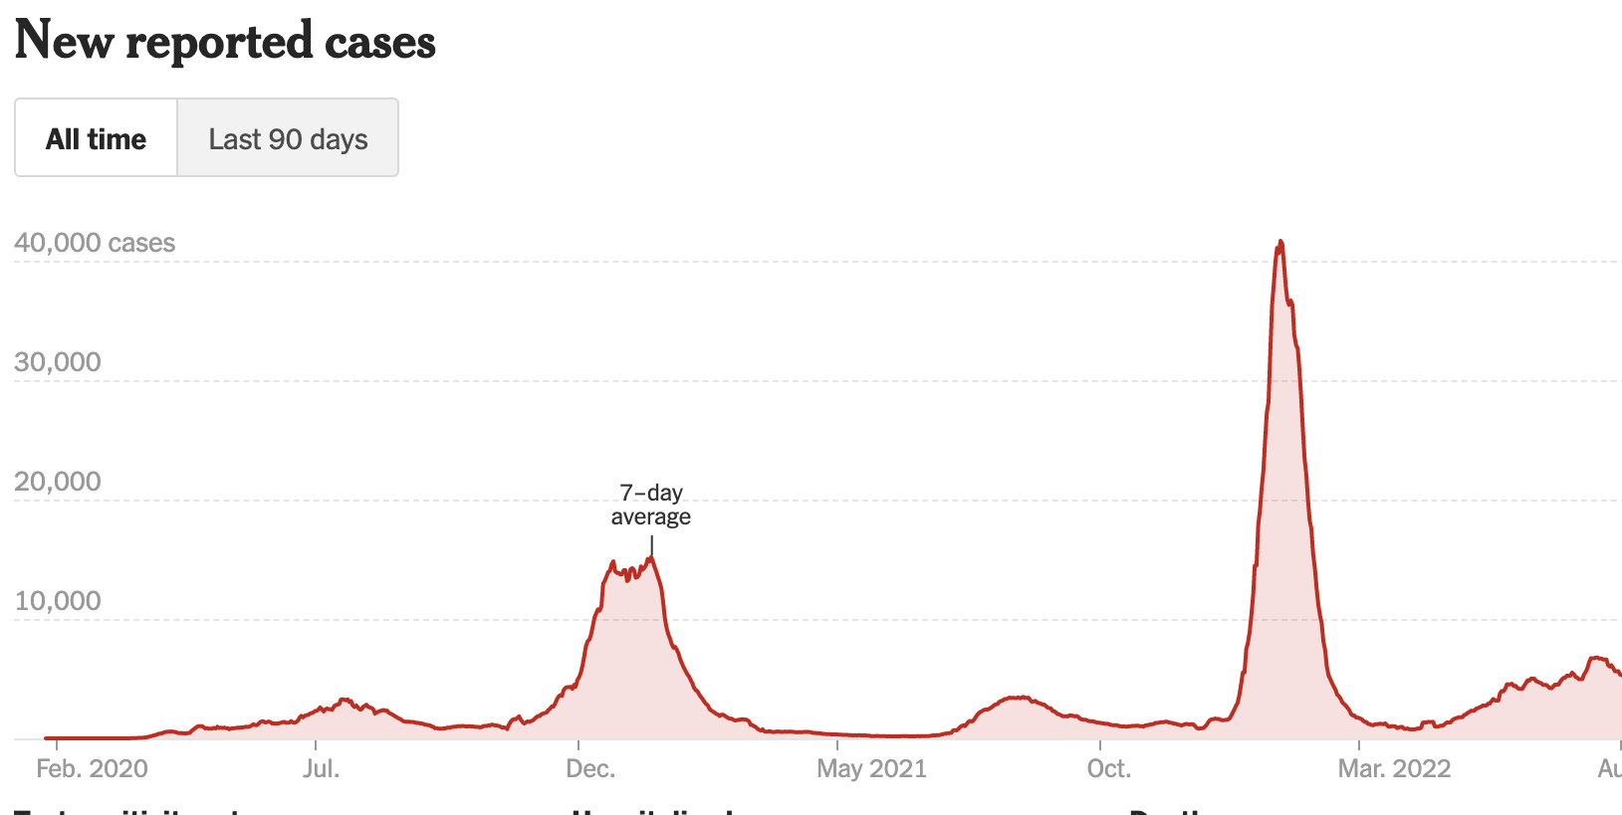
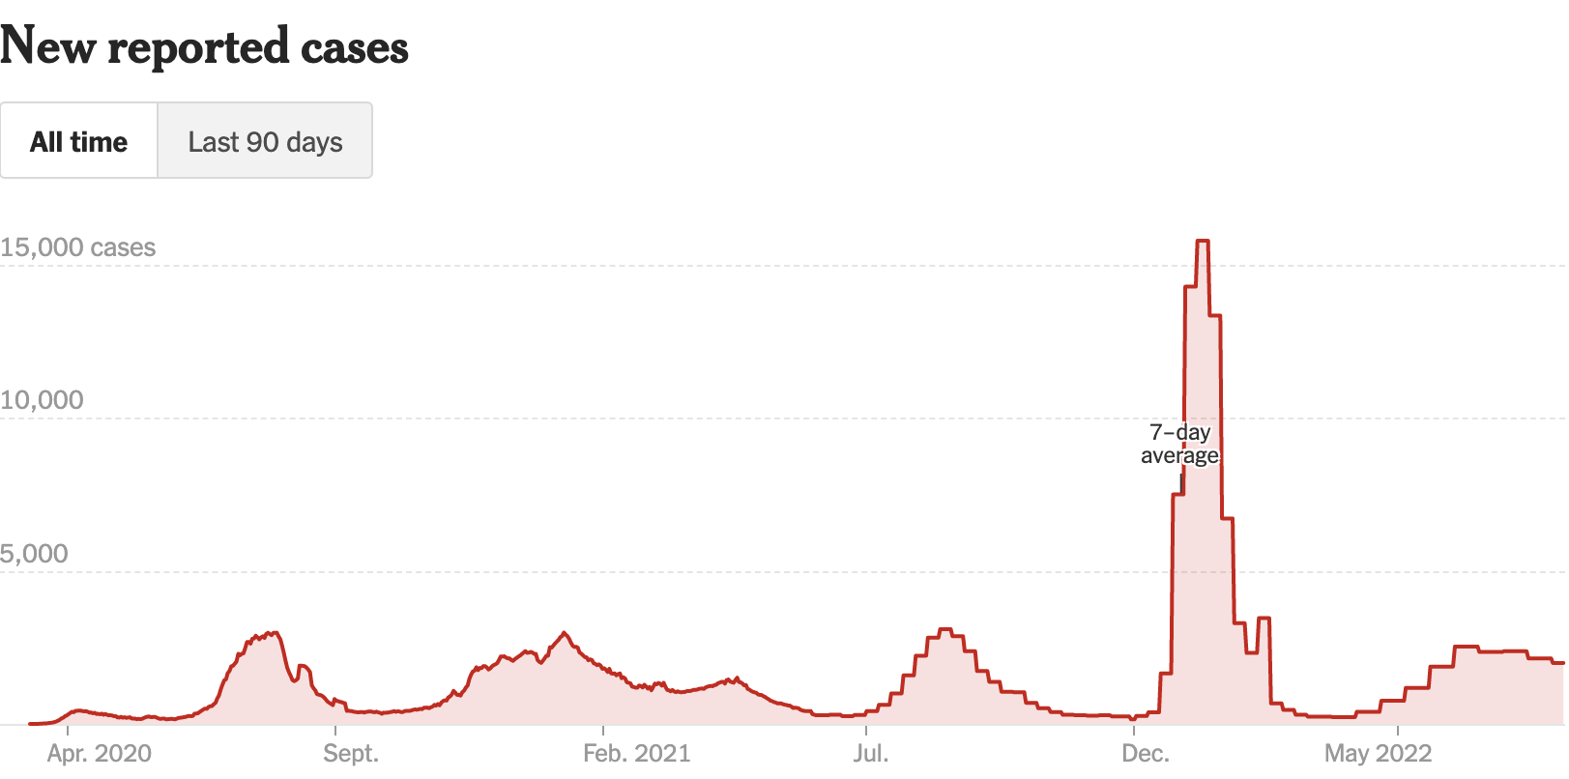
Selection of Cities: NIOSH
Interviews completed
October 2021-April 2022.
Los Angeles, CA
LA and Miami peaked relatively later on as compared to NYC and NOLA, and both had major surges in winter 2020.
Interviews completed
October 2021-June 2022.
Miami, FL

Slide 10
Sample: Greenwall
Participant characteristics (n = 79) | n (%)
Age
30-39 | 34 (43)
40-49 | 33 (42)
50-64 | 11 (14)
65+ | 1 (1)
Gender
Female | 46 (58)
Male | 33 (41)
Race
White | 62 (79)
Black or African American | 2 (3)
Asian | 15 (19)
Ethnicity
Non-Hispanic | 75 (95)
Hispanic | 4 (5)
Medical specialty
Internal medicine/hospital medicine | 29 (37)
Emergency medicine | 19 (24)
Pulmonary/critical care | 18 (23)
Palliative care | 5 (6)
Other (redeployed) | 8 (10)
Mean years practicing medicine post-residency | 9.8
 | New York City (n=40) | New Orleans (n=39) | Total
Hospital type
Academic | 18 (45) | 23 (59) | 41 (52)
Community | 7 (18) | 10 (26) | 17 (22)
Public | 15 (38) | 6 (15) | 21 (27)
Hospital funding structure
Voluntary nonprofit | 25 (63) | 19 (49) | 44 (56)
Proprietary | 0 (0) | 13 (33) | 13 (17)
Governmental (city, federal) | 15 (38) | 7 (18) | 22 (28)
Safety net status | 20 (50) | 10 (26) | 30 (38)
Hospital bed count
0-200 | 2 (5) | 12 (31) | 14 (18)
201-700 | 9 (23) | 17 (44) | 26 (33)
701-1000 | 23(58) | 10 (26) | 33 (42)
1001+ | 6 (15) | 0 (0) | 6 (8)
New York City: 14 hospitals total
New Orleans: 9 hospitals total

Slide 11
Sample: NIOSH
Participant characteristics (n = 66) | n (%)
Age
20-29 | 2 (3)
30-39 | 35 (53)
40-49 | 15 (23)
50-64 | 11 (17)
65+ | 2 (3)
Not reported | 1 (2)
Gender
Female | 34 (52)
Male | 23 (48)
Race
White | 40 (61)
Black or African American | 2 (3)
Asian | 20 (30)
Biracial | 3 (5)
Ethnicity
Non-Hispanic | 55 (83)
Hispanic | 11 (17)
Medical specialty
Internal medicine/hospital medicine | 24 (36)
Emergency medicine | 12 (18)
Pulmonary/critical care | 17 (26)
Palliative care | 8 (12)
Other | 5 (8)
 | Los Angeles (n=36) | Miami (n=30) | Total
Hospital type
Academic | 12 (33) | 15 (50) | 27 (41)
Community | 17 (47) | 4 (13) | 21 (32)
Public | 7 (19) | 11 (37) | 18 (27)
Hospital funding structure
Voluntary nonprofit | 14 (39) | 18 (60) | 32 (48)
Proprietary | 0 | 1 (3) | 1 (2)
Governmental (city, federal) | 22 (61) | 11 (37) | 33 (50)
Safety net status | 7 (19) | 12 (40) | 19 29)
Hospital bed count
0-200 | 4 (11) | 3 (10) | 7 (11)
201-700 | 32 (89) | 15 (50) | 47 (71)
701-1000 | 0 | 2 (7) | 2 (3)
1001+ | 0 | 10 (33) | 10 (15)
Los Angeles: 14 hospitals total
Miami: 6 hospitals total
Notes:
.

Slide 12
Research snapshot: Responses to question about “most challenging stressors” during pandemic
LEVEL | FREQUENCY | TOP SUBTHEMES
Individual | 84 | Concerns about viral exposure/and family safety (n=48) Social isolation (n=12) Balancing work and family obligations (n=10)
Institutional | 55 | Volume of deaths (n=14) Workload/patient volume (n=14) Resource constraints (n=8) Constantly evolving work conditions (n=5)
Professional | 64 | Medical uncertainty/suboptimal care (n=30) Caring for patients without family support (n=15) Concern for healthcare worker colleagues (n=11)
Societal | 33 | Mistrust toward physicians/COVID skepticism (n=11) Uncertainty around the course of pandemic (n=8) Frustration with the public (n=6) Frustration with the CDC response (n=3)

Slide 13
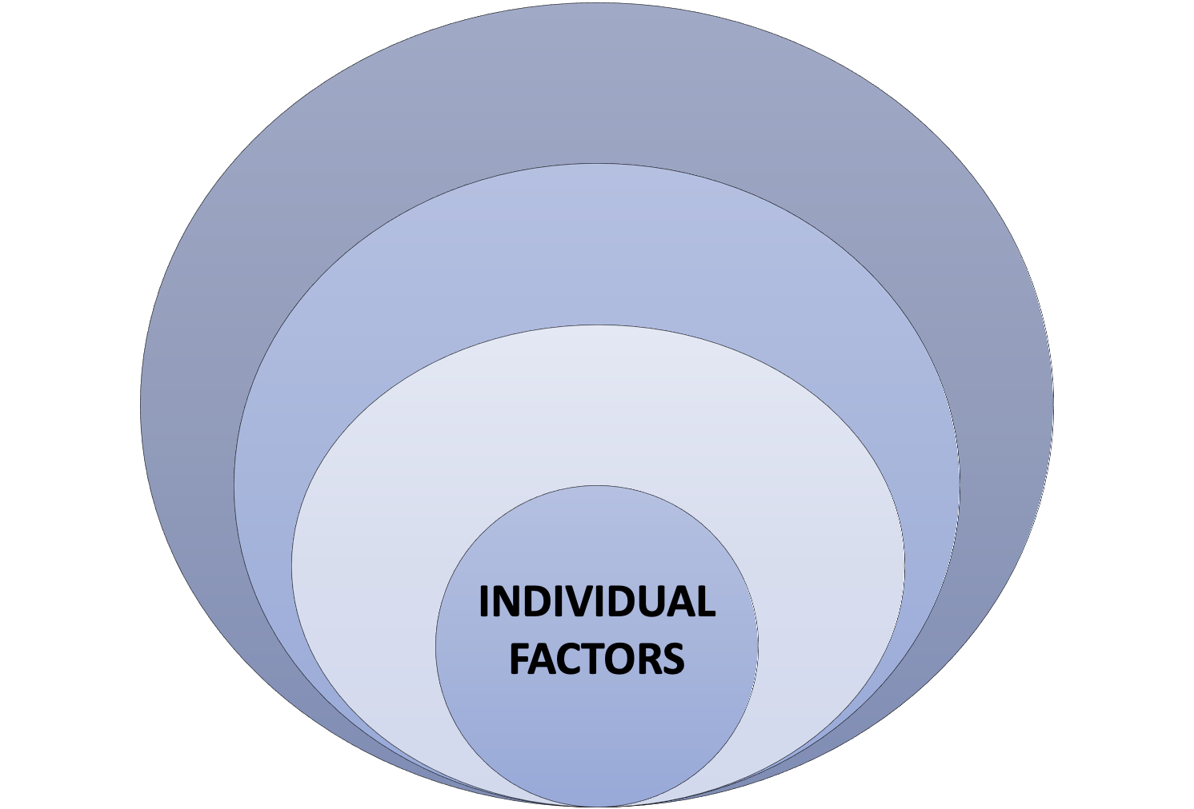
INDIVIDUAL
“I don’t think I realize at the time, but I was having panic attacks. That became an issue for me. It was from, I guess, PTSD or whatever was happening. Yeah, just the volume of work being too much or more than I was used to and feeling under-supported or unsupported. And part of that was, I was so quick out of residency. I was so green to being on my own anyway and then, sort of, being thrust into this situation where we didn’t have any data and didn’t even know how to take care of these people. And I already was still learning how to do this on my own. That was a challenging part for me, too.” (0212C, female hospitalist, community hospital, NOLA)
But the institutional context matters!
Working night shifts
Only MD overnight
Covering ICU with no CC backup
Small community hospital

Slide 14
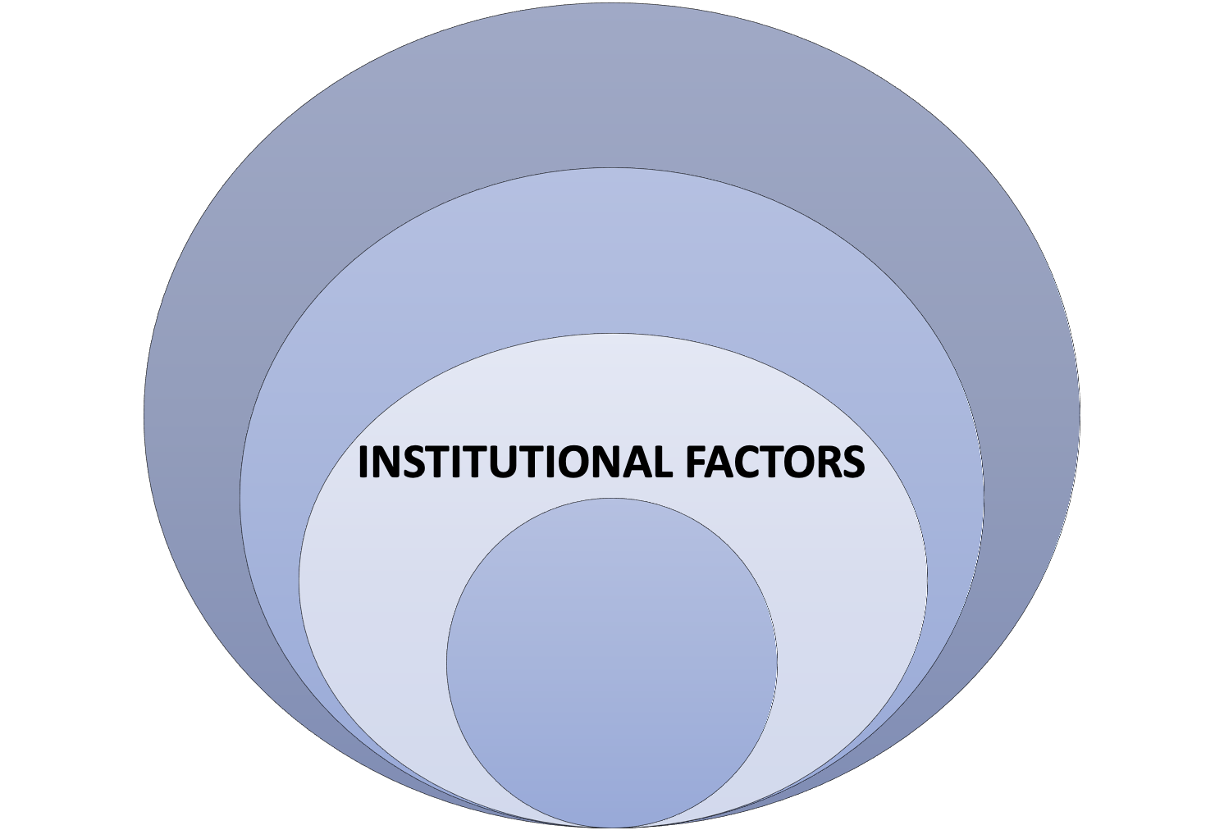
INSTITUTIONAL
“I would say, there was a dichotomy between private institutions and public institutions. For example, my institution worked with a lot of private institutions to give them ventilators that they weren’t using and all of that. They didn’t do the same thing for the public hospital. And I think it created that tale of two cities that often is the reference to the way that this crisis was managed, and other crises as well. That if you’re poor, you live in certain neighborhood and all of that, you’re going to receive poor care.” (0106, male, pulmonary critical care, academic hospital, NYC)

Slide 15
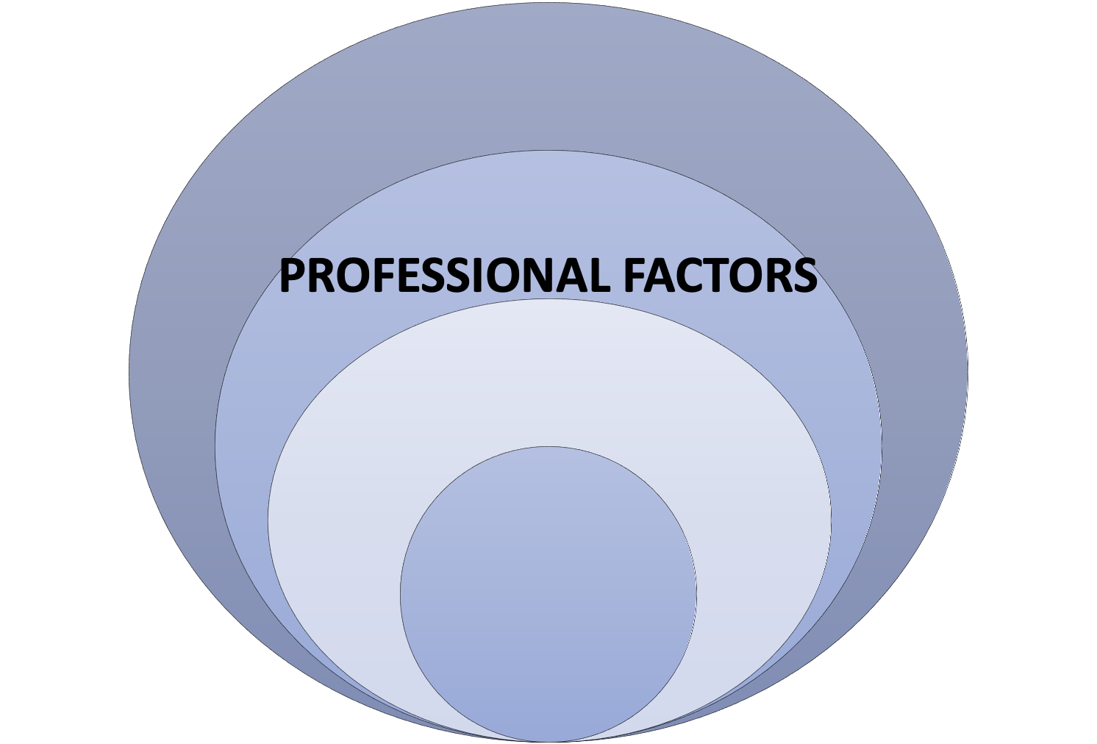
PROFESSIONAL
“I think that was pretty distressing, certainly for me, and probably for other clinicians, where they felt like either they were implicitly rationing care, or they weren’t providing the usual level of care that they’re accustomed to providing.” (0115, male hospitalist, public hospital, NYC)
“When we had to intubate somebody emergently, after vaccines were available, I would literally announce, I said, “I don’t care if you’re vaccinated or not. But if you’re not, please get out of the room, because I’m not going to be responsible for exposing you for no reason, I got plenty of people I can work with who are.” And I would watch people leave. And I was like, “I’m literally trying to protect you. And I’m annoyed that I have to do this, but also I rather you not get exposed if you don't have to.” (0401, female critical care pulmonologist, Miami)

Slide 16
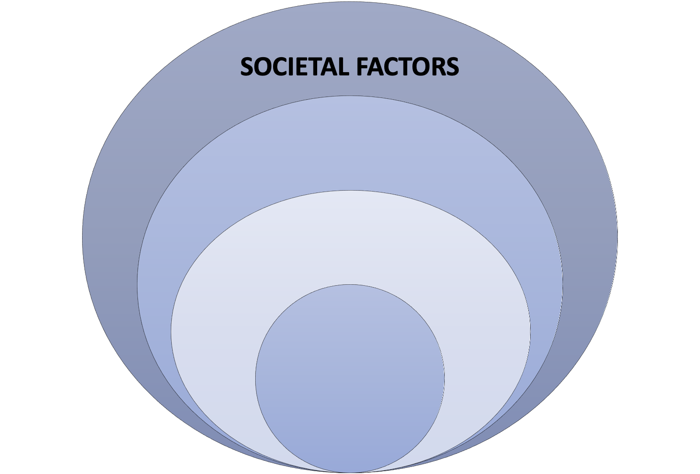
SOCIETAL
“It felt just over and over again as if we were just, sort of, left out to hang, like hung out to dry. That there was no... I guess we all had the sense, at the beginning, like, ‘We’re in America. This is a great country. We have resources. Even if everything isn’t perfect in the healthcare system, the state will come through, FEMA will be there. There will be some sort of centralized response to this thing and we’ll get help.’ And it just didn’t happen.” (0119, female, emergency medicine, public hospital, NYC)

Slide 17
SOCIETAL
“This is not what I signed up for. I get disrespected. They’re difficult. They’re obstinate. We get verbally harassed. It’s not fulfilling. It’s discouraging. It’s pretty hard to keep on going when you have to go in and face these kinds of working conditions.” (0318, male, critical care pulmonologist, academic hospital, LA )
  z
Interviewer: Gosh. Like in those situations [being confronted with inequities in care], what does that feel like? Is there like a frustration, a sadness?
Participant: I think all of the above. It depends what mood I'm in. But I mean, I'm sure it's like partly anger, partly frustration, partly sadness, partly just like this is what it is. … There are only certain things you have control over and to get angry or upset about things that you can't or don't, then it's just a waste of what finite limited energy and emotions that you have. … But at some point, this is probably why we're all burning out now.” (0315, male, emergency medicine, community hospital, LA)

Slide 18
“Silver linings” and sources of resilience
Finding meaning in professional identity. “I'm thankful that I was able to help a lot of people in probably their worst moments of their life. … I’m grateful for that.” (0417 Miami)
Strengthening team solidarity. “Everybody was dealing with crazy stuff. So, you know, it was unifying. I think everybody was kind of working together to try to, you know, help each other, because we knew that we were the only ones there, and that we needed to stick together.” (0410, Miami)
Getting rid of “stupid stuff.” “All of these kind of like pet projects and side distractions to like getting serious work done just stopped, and this got pushed way up to the front.” (0203, NOLA)
Sharing of information and resources across institutions: “That was one of the amazing things, just the connectivity and sharing between physicians around town that I never experienced before.” (0209, NOLA)

Slide 19
“How have you been feeling about your job during the pandemic?”
Many responded very positively. (n=23) These participants reflected on the meaning they found in working during the pandemic, their gratitude for stable employment, the appreciation and support they received from hospital leadership, their accomplishments, and their ability to practice without the usual “bullshit.” n=23
Many responses were truly mixed. (n=24) Some commented on pride and exhaustion at the same time, while others reflected on a rollercoaster of emotions: feeling burned out in certain phases and gratified in others.
Only a handful responded very negatively. (n=8) These participants described feelings of resentment, abandonment, and burnout.

Slide 20
What changes would you recommend to improve physician stress and wellbeing?
Leadership communication and planning
Regular, consistent, transparent communication around decisions and policies (n=19) Better leadership planning (proactive, not reactive), including crisis standards (n=11) Listen to physicians and engage their feedback (n=9) Check in on staff wellness and needs (n=8)
Material support
Hire more staff (n=14) Provide food and drinks (n=10) Access to testing and adequate PPE (n=8) Hazard pay (n=7) Childcare support (n=6) Adequate supplies and resources (n=6)
Mental health support and infrastructure
Institutional initiatives (n=13) Destigmatize mental illness (n=9) Insurance coverage for therapy/improve access to therapy (n=8)
Opportunities to rest
Flexible schedules (n=14) More paid vacation time (n=7) Offer more sick time/destigmatize sick days (n=5)

Slide 21
Takeaways
Understanding and combatting stress and burnout in contemporary medicine demands a systems perspective.
Interview findings reflect relationships among health systems, work environments, professional norms, and individual wellbeing. Focusing solely on “heal thyself” interventions does not acknowledge or mitigate system-produced stressors.
Medical institutions may fail physicians twice: by fostering occupational stress and risk of burnout, and then by failing to respond to these threats to health and wellbeing.

